Slide 1
Legal Epi at Lunch:
Legal Data for Drug Policy
Alexandra Hess, JD, MPH
Jonathan Larsen, JD, MPP
Kate Boulton, JD, MPH
Derek Carr, JD
CENTER FOR PUBLIC HEALTH LAW RESEARCH
February 15, 2024

Slide 2
Legal epidemiology
The scientific study and deployment of law as a factor in the cause, distribution, and prevention of disease and injury in a population.
Notes:
Legal epidemiology, also referred to as public health law research, is the scientific study and deployment of law as a factor in the cause, distribution, and prevention of disease and injury in a population.
This includes both direct relationships between law and health and relationships mediated through the impacts of law on health behaviors and other processes and structures that affect population health. Legal epidemiology uses a scientific approach. A scientific approach to understanding how law influences the delivery of public health law services and population health is crucial to assessing whether it does so and what law-based strategies work best.

Slide 3
Policy surveillance
The systematic collection, analysis, and dissemination of laws and policies across jurisdictions or institutions, and over time.
Notes:
Policy surveillance allows anyone in public health law to keep the focus on law and keep the people you work with, and the public informed about important trends.
Policy surveillance uses a rigorous scientific process to create data for evaluation and empirical research. It tracks public health laws and policies across space and over time. it is the necessary first step of legal epidemiology, as if you want to study the effects of the law, you need to know what the law says

Slide 4
Access Data
LawAtlas.org
Home to 125+ freely-available public health legal datasets
Full datasets are available in Excel format or through an interactive map
PDAPS.org
Funded by the National Institute of Drug Abuse to track key state laws related to drug abuse
Created using the policy surveillance process
New datasets on state opioid-related policies relevant to the criminal justice system

Slide 5
The Policy Surveillance Process
Defining the scope
Collecting the law and creating the legal text
Coding the law
Publication and dissemination
Tracking and updating the law
Conducting background research
Developing coding questions
Quality control

Slide 6





Why policy surveillance matters
Create reliable data for evaluation
Create accessible,
non-partisan information
Track change over time & measure progress
Diffuse innovative policy ideas
Build workforce capacity
Notes:
Creates data suitable for use in rigorous evaluation studies.
The rigorously produced data supports more nuanced analysis and evaluation than simple observation of whether a law on a certain topic exists or not
Surveillance datasets can be created in longitudinal form, or may naturally evolve from cross-sectional data (which captures a snapshot of the law at a point in time) into longitudinal data, through ongoing monitoring and updating during which successive versions of the law are added to the database rather than replacing existing information
Longitudinal policy data supports quasi-experimental and other more rigorous observational designs that better support causal inference than cross-sectional studies capturing only one point in policy time
Longitudinal policy data allows researchers to identify changes in policy over a period of time
The greater availability of reliable data will lower the cost, and can potentially speed evaluation of important policies.
Creates accessible, non-partisan information
By turning the law into data we create an objective evidence base of what the law says, free of any partisan language.
Track progress.
Policymakers can see what elements of laws have the most movement in other states.
Advocacy groups can track the progress of campaigns and efforts to change laws and determine where to focus efforts and resources.
Social scientists can access scientifically sound data that can be used to evaluate the health influences of the laws.
Government agencies can use this as a metric for the success of larger programs. For example, when Healthy People 2030 makes a recommendation to enact a certain law, policy surveillance is the best way to measure the achievement of that goal.
Supports diffusion of innovation.
Jurisdictions seeking to address a particular public health issue may use surveillance data to learn what others are doing.
Addresses the chronic lack of readily accessible non-partisan information about status and trends in legislation and policy
Policymakers proposing the adoption of a law can see where such legislation already exists, and what it looks like.
Improves transparency and accountability for the public health system.
Supports the opportunity to build policy capacity in the public health workforce, and supports its exercise.
Policymakers and other staff can learn to track their own laws for accreditation or program purposes
Staff and the public have easier access to the key health laws in the community
Knowing the policy terrain helps health professionals measure progress and plan initiatives

Slide 7
Legal Epi for Drug Policy
Much of drug policy is regulated at the state level, where there is often significant variation in how states have responded (or failed to respond) to the ongoing opioid overdose epidemic
  Licensure
  Drug criminalization (or decriminalization)
  Good Samaritan laws
  Access to naloxone
  Access to medications and treatment for Opioid Use Disorder (OUD)
  Prescription drug monitoring
  Syringe service programs
Notes:
Opioids comprised 75% of all drug overdose deaths in 2021 (75.4% of all drug overdose deaths).

Slide 8
Legal Epi for Drug Policy
Comprehensiveness of state policy to prevent overdose deaths
Buprenorphine prescribing requirements and limitations
Notes:
Opioids comprised 75% of all drug overdose deaths in 2021 (75.4% of all drug overdose deaths).

Slide 9

Jonathan Larsen,
Center for Public Health Law Research
Notes:
Jonathan Larsen is a Legal Program Manager at Temple University’s Beasley School of Law Center for Public Health Law Research. His research focuses on drug policy and access to healthcare. Prior to working at the Center, Jon spent several years as a health policy consultant, providing federal and state legislative and regulatory analysis for biopharma clients. He has broad health policy experience, particularly in oncology, having served in policy roles at the American Society of Clinical Oncology (ASCO) and the National Comprehensive Cancer Network (NCCN), where he also managed international business development. Jon holds a J.D. from Temple University’s Beasley School of Law, an M.P.P. from George Mason University’s Schar School of Policy and Government, where he was a Bryce Harlow Foundation Fellow, and a B.A. from Tufts University.

Slide 10

Kate Boulton,
Vital Strategies
Notes:
Kate Boulton is a legal and public health professional and is currently Senior Legal Technical Advisor to the Overdose Prevention Program at Vital Strategies. She focuses on drug policy, overdose, harm reduction, and strategies to promote the rights and health of people who use drugs. Prior to joining Vital Strategies, Kate worked as Staff Attorney at the Center for HIV Law and Policy. She served with the Centers for Disease Control and Prevention from 2007-2012 in the Division of Global Migration and Quarantine. Kate earned her JD from Harvard Law School and her MPH from the University of Michigan.

Slide 11

Derek Carr,
Vital Strategies
Notes:
Derek Carr is a public health attorney who currently serves as Legal Technical Advisor for the Vital Strategies Overdose Prevention Program. In this role, Derek supports local, state, and federal initiatives to advance public health and harm reduction approaches to substance use and overdose. Derek was previously a Senior Attorney at ChangeLab Solutions and a Legal Fellow at the Network for Public Health Law. He earned both his BA and JD from the University of North Carolina - Chapel Hill.

Slide 12

Stop Overdose Deaths:
Monitoring Comprehensiveness of State Policy to Prevent Overdose Deaths

Slide 13
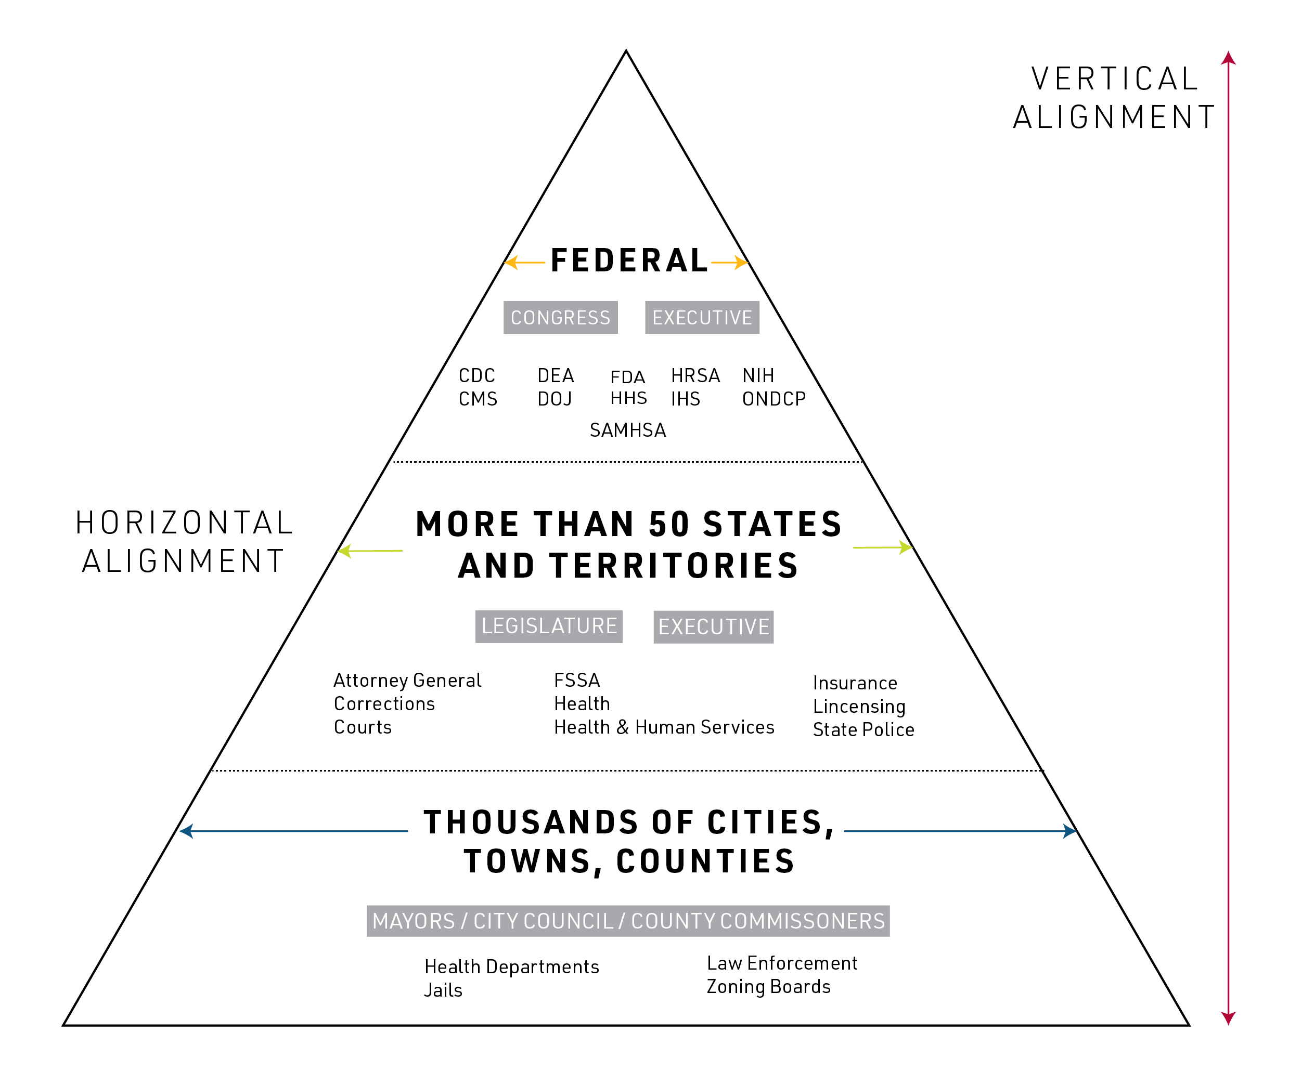
A Whole-of-Government Approach
Notes:
After more than 20 years of unacceptable opioid overdose deaths, government is still not pulling together as it should. The original whole-of-government response to drugs aka “the War on Drugs” has failed: both lack of horizontal cooperation across the federal, state and local governments, and lack of vertical cooperation between government levels. A whole of government approach is needed to improve coordination and remove sand from the gears. But how do we get there? We focused on legal barriers to W-G cooperation: laws that take the response in opposite directions, or that lead to one part of government blocking the initiatives of another, or that simply fail to enable and promote W-G cooperation to address the opioid crisis. Many of the policies we mention have been widely seen as important: our contribution is to specify the legal actions that need to be taken for them to work.
Many agencies and divisions of government have an influence on OUD prevention, treatment, and recovery yet their efforts are often poorly aligned. Researchers from Temple University and Indiana University will showcase effective ways of aligning law and policy at a single level of government (“horizontal alignment”) or at multiple levels (“vertical alignment”).

Slide 14
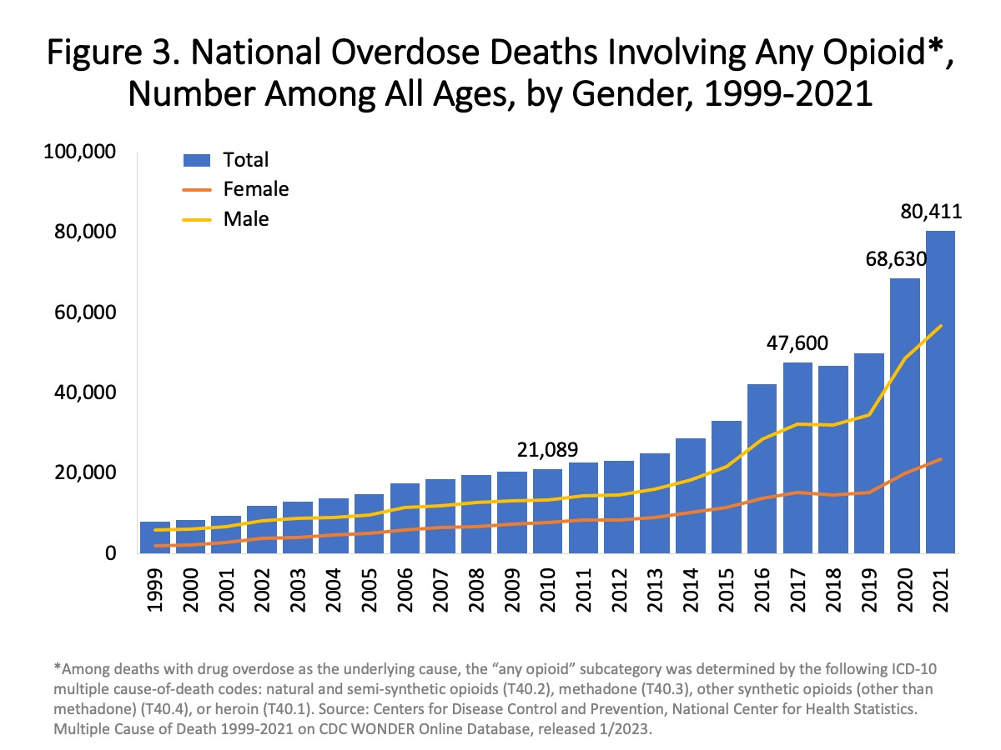
Years and Years of Terrible Impact
Notes:
https://nida.nih.gov/research-topics/trends-statistics/overdose-death-rates

Slide 15
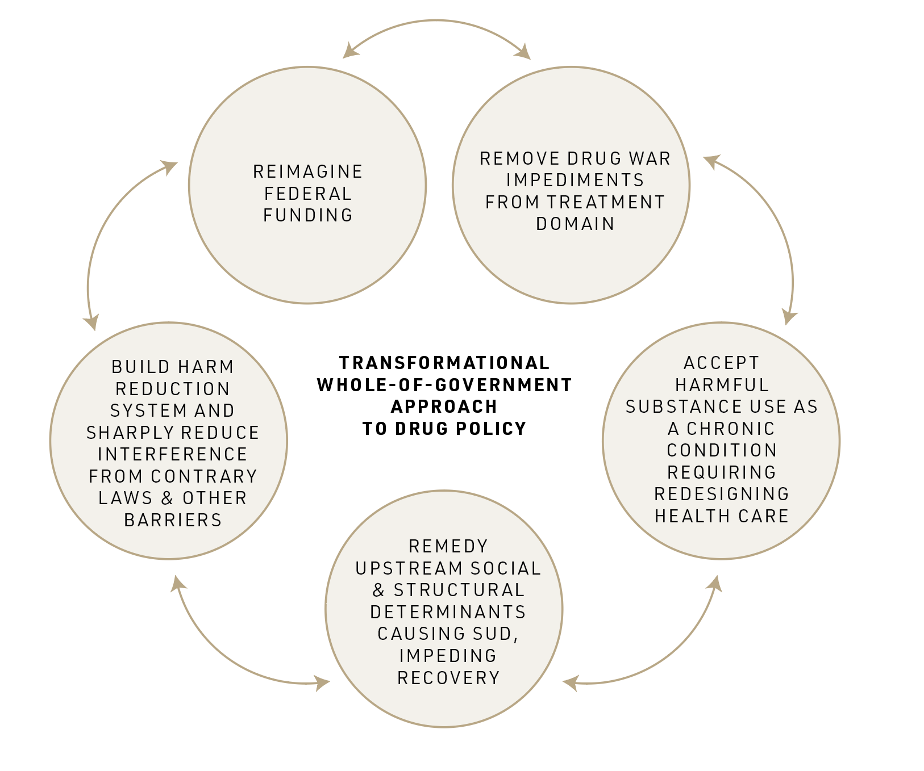
Transformational Model
No more policy “pillars”
No more drug war
Notes:
Traditional approaches have not stopped the crisis. We have moved away from the conventional framework by being explicit that criminalization creates pervasive legal barriers to effective action, and a three decades crisis demands that we address root causes of SUD. Overdose deaths have continued to rise and US life expectancy has fallen.
These are components of a transformational Whole-of-Government approach to drug policy.

Slide 16
We reviewed the evidence
Notes:
White papers published November 2023

Slide 17
We reviewed the evidence
Notes:
White papers published November 2023

Slide 18
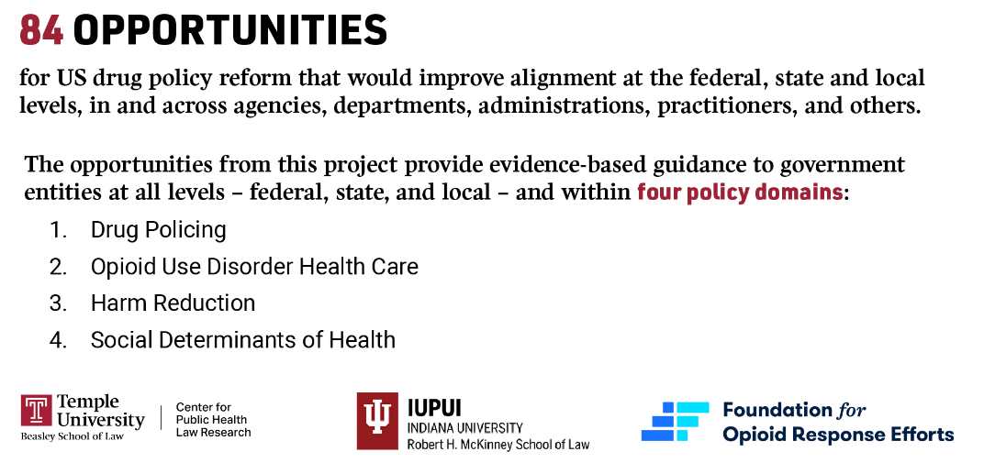
Notes:
The opportunities identified from this project provide guidance to government entities at all levels — federal, state, and local — and within four overall policy domains: drug policing (DP), harm reduction (HR), health care (HC) and social determinants of health (SD). The opportunities are either explained in more detail in our series of white papers or derive from concepts in those white papers.

Slide 19
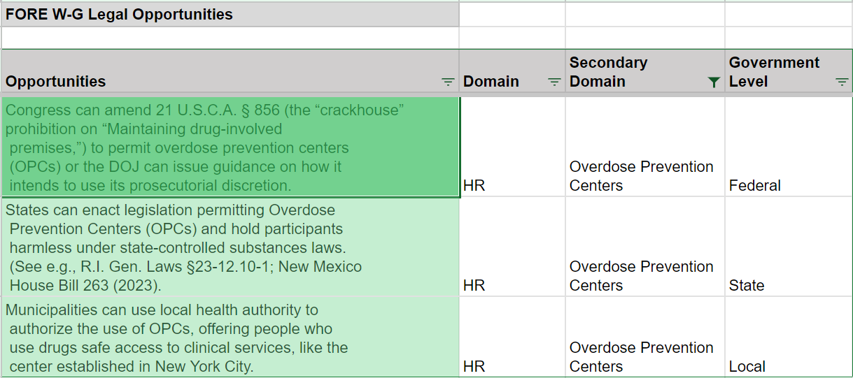
Synthesis of Shovel-ready Legal Opportunities
*This is an example from our interactive database was made available on PHLR.org allowing legal opportunities to be sorted: The Legal Path to a Whole of Government Opioids Response | Public Health Law Research (phlr.org)

Slide 20
Synthesis of Shovel-ready Legal Opportunities
Local Opportunities
Local governments can enact ordinances requiring pharmacies to maintain stocks of buprenorphine and naloxone. (See, e.g., Philadelphia, Pennsylvania Municipal Code § 9-637). HC
Local governments can integrate SSPs and remove any special zoning requirements for SSPs and OTPs. HR
Public housing agencies can narrowly specify grounds for denying housing based on drug-related behavior. SD
State Opportunities
States can enact legislation permitting Overdose Prevention Centers (OPCs) and hold participants harmless under state-controlled substances laws. (See e.g., R.I. Gen. Laws §23-12.10-1; New Mexico House Bill 263 (2023). HR
States can encourage help-seeking behavior during overdose events by repealing or providing immunity to Drug Induced Homicide (DIH) laws. DP
States can address gaps in coverage from citizens returning from correctional settings by applying for Section 1115 waivers to expand Medicaid prerelease services. See e.g., California’s 1115 waiver. HC
Federal Opportunities
Congress can address gaps in access to OUD health care caused by a lack of public or private insurance by enacting a funding program similar to the Ryan White HIV/AIDS Program by which services are provided through “payor of last resort” federal funds for low-income people, the uninsured or underserved, 42 U.S. Code § 300ff–27(b)(7)(F). HR
Congress can amend 21 U.S.C.A. § 856 (the “crackhouse” prohibition on “Maintaining drug-involved premises,”) to permit overdose prevention centers (OPCs) or the DOJ can issue guidance on how it intends to use its prosecutorial discretion. HR
Congress can broaden federal expungement to include more nonviolent crimes such as in the proposed Fresh Start Act of 2022, H.R.6667, 117th Congress (2021-2022). SD

Slide 21
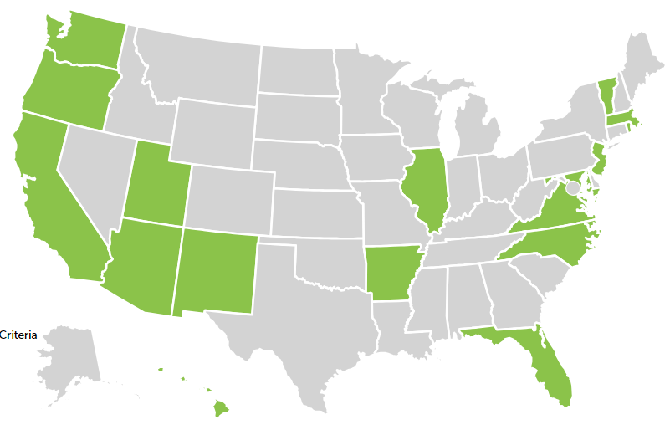

Health Care: Medicaid Expansion/1115 Waivers
Seventeen states have Section 1115 Medicaid waiver with a form of housing support as of April 20, 2023

Slide 22
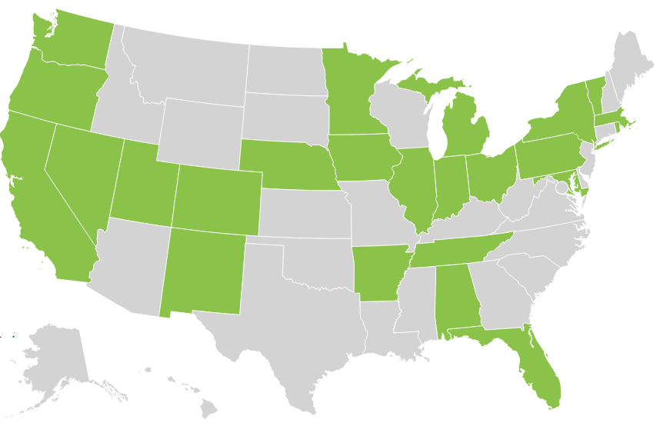
Health Care: Incarceration Effects on Medicaid Status Laws
Twenty-four states have a law or regulation suspending rather than terminating Medicaid status upon incarceration in prison as of June 1, 2023.

Slide 23
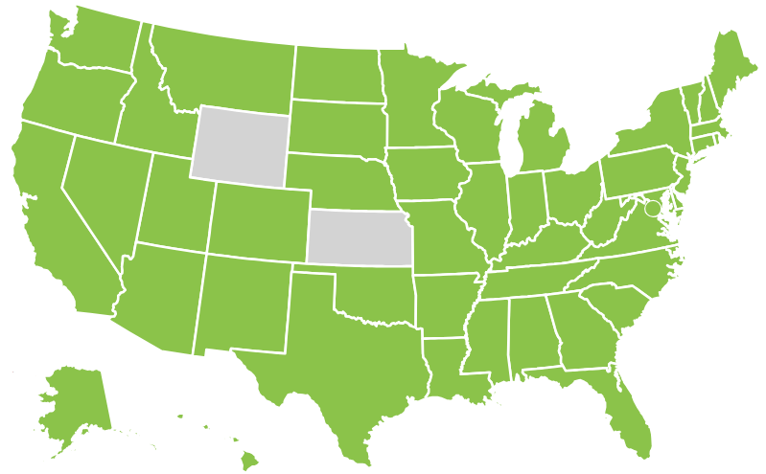
Harm Reduction: Good Samaritan Drug Overdose Laws
Forty-eight states and the District of Columbia have Good Samaritan Drug Overdose Laws as of January 1, 2023

Slide 24
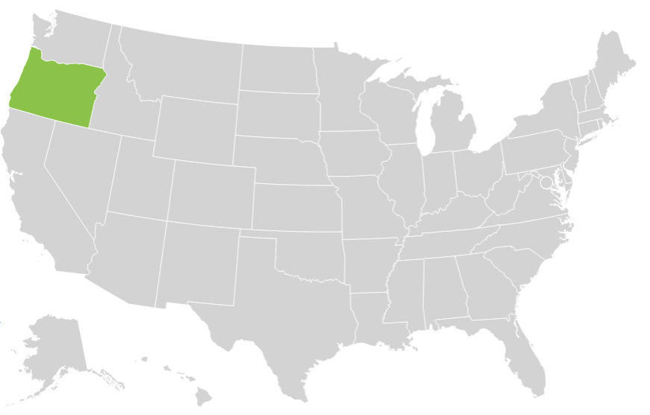
Criminal Law: Drug Decriminalization Laws
Only one state (Oregon) has a state law in effect that decriminalizes personal possession of controlled substances.
Notes:
Data is complete – working on publication

Slide 25
Thank You!
Jonathan Larsen, JD, MPP
Legal Program Manager
Center for Public Health Law Research
Email: Jonathan.Larsen@temple.edu

Slide 26
Buprenorphine Prescribing Requirements and Limitations
February 15, 2024
The information in this presentation does not constitute legal advice or legal representation

Slide 27
Presenters
Kate Boulton, JD, MPH
Senior Legal Technical Advisor
Vital Strategies
Derek Carr, JD
Legal Technical Advisor
Vital Strategies

Slide 28

Vital Strategies Overdose Prevention Program
Vital Strategies is a global public health organization that believes every person should be protected by a strong public health system.
The Overdose Prevention Program is the lead implementation partner for state-focused work in the Bloomberg Overdose Prevention Initiative.
We bring a comprehensive approach to equitably and sustainably reduce overdose deaths in seven states where fatalities are among the highest in the country: Kentucky, Michigan, New Jersey, New Mexico, North Carolina, Pennsylvania, and Wisconsin.
Support Harm Reduction campaign

Slide 29
Agenda
Setting the Context
Key Findings
Next Steps and Opportunities

Slide 30
Federal Legal Framework: Brief Historical Context
1914
1970-1974
2000
2002
2016-2018
Dec. 2022
Harrison Narcotics Tax Act Enacted
Adoption of the Controlled Substances Act and Narcotic Addict Treatment Act
Drug Addiction Treatment Act of 2000 (DATA 2000)
X-Waiver Established
FDA approves buprenorphine for treatment of OUD
Incremental expansion of X-waiver eligibility
Federal legislation eliminates the X-waiver

Slide 31
Buprenorphine Prescribing Requirements and Limitations
Dataset Scope
State-level statutes and regulations that specifically apply to prescribing buprenorphine for opioid use disorder.
Legal data current as of March 1, 2023 – updates planned.
The dataset does not capture:
  Generally applicable controlled substance laws.
  Generally applicable practitioner scope of practice laws.
  Laws governing the prescribing of buprenorphine for conditions other than OUD.
  Laws on use of buprenorphine in federally certified opioid treatment programs (OTPs).
  Laws that apply only within state Medicaid programs.
  Sub-regulatory policies (e.g., Medicaid state plans, private insurer policies).

Slide 32
Why examine state laws on buprenorphine prescribing for OUD?
Increasing recognition of the need for low-barrier SUD treatment, including low-barrier buprenorphine access – and the need to address regulatory impediments to low-barrier treatment.
  “Policymakers and stakeholders must work to identify and address any inhibitors to low barrier care, including funding and reimbursement, workforce development, and regulatory policies.”
  SAMHSA Advisory: Low Barrier Models of Care for Substance use Disorder (Dec. 2023)
Efforts to remove legal barriers to expanded buprenorphine access have focused primarily on the federal level (e.g., X-waiver)
The benefits of eliminating the X-waiver will not be fully realized if restrictive state laws remain in place.
But no comprehensive public dataset existed of state-level statutes and regulations governing the prescribing of buprenorphine for opioid use disorder.

Slide 33
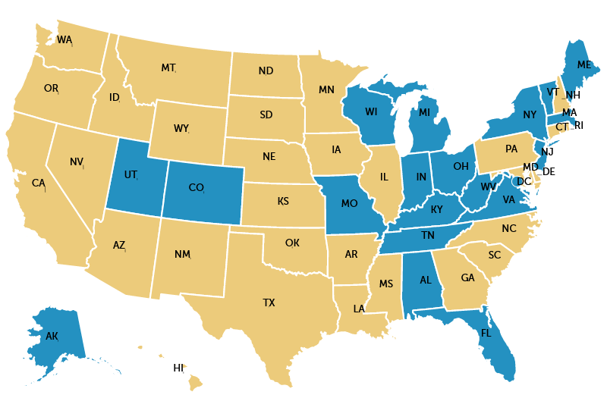
At Least 19 states & D.C. Explicitly Regulated Buprenorphine Prescribing for Opioid Use Disorder (Current as of March 1, 2023)
Laws in:
7 states applied to all buprenorphine prescribers.
3 states applied to particular types of practitioners.
2 states applied when a practitioner treats more than a specified threshold of patients.
11 states & D.C. applied in certain types of practice settings.
Fifteen (15) states incorporated outdated provisions of federal law related to the X-waiver.
Does the state explicitly regulate buprenorphine prescribing for opioid use disorder (OUD)?
http://bit.ly/3SMNdT8

Slide 34
Common Components of State Laws
Regulating of Buprenorphine Prescribing for OUD
Initial Evaluation
Counseling Requirements
Mandated Drug Testing
Visit Frequency & Prescription Length
Formulation and Dosage Restrictions
Responses to Patient “Non-compliance”
Special Populations (e.g., pregnant people)
Ancillary Services
Tapering Requirements

Slide 35
State Legal Landscape for Buprenorphine Treatment
Current as of March 1, 2023
“[S]tate policies need to minimize high-threshold practices that reduce buprenorphine treatment continuity and undermine an effective response to the overdose crisis.”¹
14 States & D.C.
17 States & D.C.
Mandated counseling for some or all buprenorphine patients. Four (4) states established a minimum frequency of counseling services.
Required drug testing when prescribing buprenorphine for OUD. Eight (8) states established a minimum frequency of drug testing.
8 States
8 States & D.C.
Regulated initiation and/or maintenance dosages. There were instances in five (5) states where dosages were restricted without exception.
Established visit frequency requirements for some or all patients prescribed buprenorphine. Five (5) states + D.C. applied these requirements for the duration of treatment.
¹ Lyle V, Harris S, Heidari O, et al. Association between high-threshold practices and buprenorphine treatment termination. International Journal of Drug Policy. 2024;124:104318.
Source: Center for Public Health Law Research Staff & Vital Strategies. Buprenorphine Prescribing Requirements and Limitations (March 1, 2023). Available at https://pdaps.org/datasets/buprenorphine-prescribing-requirements-and-limitations.

Slide 36
14 States Regulated Responses to Patient “Non-compliance”
Current as of March 1, 2023
Types of “Non-compliance”¹
Drug screen results (10)
  Positive for illicit drugs (7)
  Abnormal results (4)
  Negative for prescribed medication (3)
Refusal of or inadequate engagement with counseling (5)
Medication diversion (5)
Return to use (4)
Refusal or inadequate engagement with other services (4)
Polysubstance use (2)
Other (8)
¹ Non-exhaustive list.
Permitted and/or Required Responses²
Reassess treatment plan (9)
Documents the patient’s non-compliance (6)
Referrals for additional or more specialized treatment (4)
Increased frequency of drug screens (3)
Prohibits involuntary discharge (3)
Discourages involuntary discharge (2)
Increased frequency of appointments (2)
Responses not specified (2)
Prohibits dosage reductions (1)
Other (6)
² Non-exhaustive list. Specified responses do not necessarily apply to all types of “non-compliance.”

Slide 37

But state laws can also be more supportive of low-barrier, patient-centered care
Prohibiting discharge based solely on drug screen results
“The Licensed or Approved Provider's Medical Director shall ensure drug screen results are not used to force a patient out of treatment, but are used as an aid in making treatment decisions.”¹
Prohibiting discharge based on declining counseling or other ancillary services
“An OBOT provider may not deny or discontinue MAT based solely on a patient's decision not to follow a referral or recommendation to seek counseling or other behavioral interventions unless the patient is otherwise non-compliant with the treatment agreement.”²
Prohibiting punitive dosage changes
“Adjustments upward or downward in dosage shall not be made either as punishment or reward but shall be justified by the clinical documentation of the patient’s condition, subjectively and objectively.”³
Requiring direct provision of or a prescription for naloxone
“The OBOT service shall ensure that all of its patients receive the following … A prescription for naloxone.”⁴
¹ 105 Mass. Code Regs. 164.255(A)(2)
² 13 Vt. Code R. § 140 062.6.2.4.1
³ W. Va. Code R. § 69-12-16.3.b
⁴ Wis. Admin. Code, DHS § 75.60(10)(a)

Slide 38



Where do we go from here?
Use the legal data to research how restrictive and/or supportive regulatory schemes affect treatment access and outcomes.
Example: Stein BD, Saloner BK, Golan OK, et al. Association of Selected State Policies and Requirements for Buprenorphine Treatment With Per Capita Months of Treatment. JAMA Health Forum. 2023;4(5):e231102.
Understand the legal landscape in your state.
Monitor legislative & regulatory proposals.
Identify opportunities for reform.
Advocate for change! You can build on recent state-level successes.
Example: AL and MI repealed their restrictive buprenorphine laws following elimination of the X-waiver.

Slide 39

Questions?

Slide 40
Contact Information
Derek Carr
Legal Technical Advisor
Vital Strategies Overdose Prevention Program
dcarr@vitalstrategies.org
Kate Boulton
Senior Legal Technical Advisor
Vital Strategies Overdose Prevention Program
kboulton@vitalstrategies.org

Slide 41
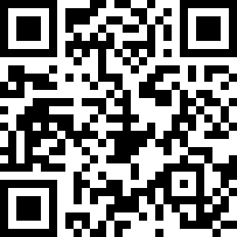
Keep in touch!
Alexandra.hess@temple.edu
Sign up for our bi-weekly newsletter: https://bit.ly/CPHLRemail
Follow us on social media
  Instagram: @templelegalepi
  X: @PHLR_Temple
  Facebook
  LinkedIn
  YouTube

Slide 42
CPHLR Resources
PHLR.org
LawAtlas.org
PDAPS.org

