Slide 1
What is Policy Surveillance?
Methods | Significance | Process | Legal Mapping Introduction
LEARNING LIBRARY
FEBRUARY 2022

Slide 2
Learning objectives
Define “policy surveillance”
Provide an overview of the policy surveillance process
Explain the importance of policy surveillance
Define “legal mapping”

Slide 3
Defining “policy surveillance”
Tracks public health laws and policies over time and across jurisdictions
Uses a rigorous scientific process to create data for evaluation and empirical research
Notes:
The systematic, scientific collection and analysis of laws of public health significance
Our work focuses on laws that are significant to public health, but policy surveillance techniques can be used for any type of law or policy
Can capture law and policy at all levels, across many jurisdictions, over time
A study that captures data over time is called a longitudinal study. A study that captures a snapshot of the law at one point in time is called a cross-sectional study.

Slide 4
What makes policy surveillance a scientific approach to collecting and analyzing laws?
It uses a systematic approach
It emphasizes transparency
The process is replicable
There is a focus on delivering a highly accurate product through quality control

Slide 5
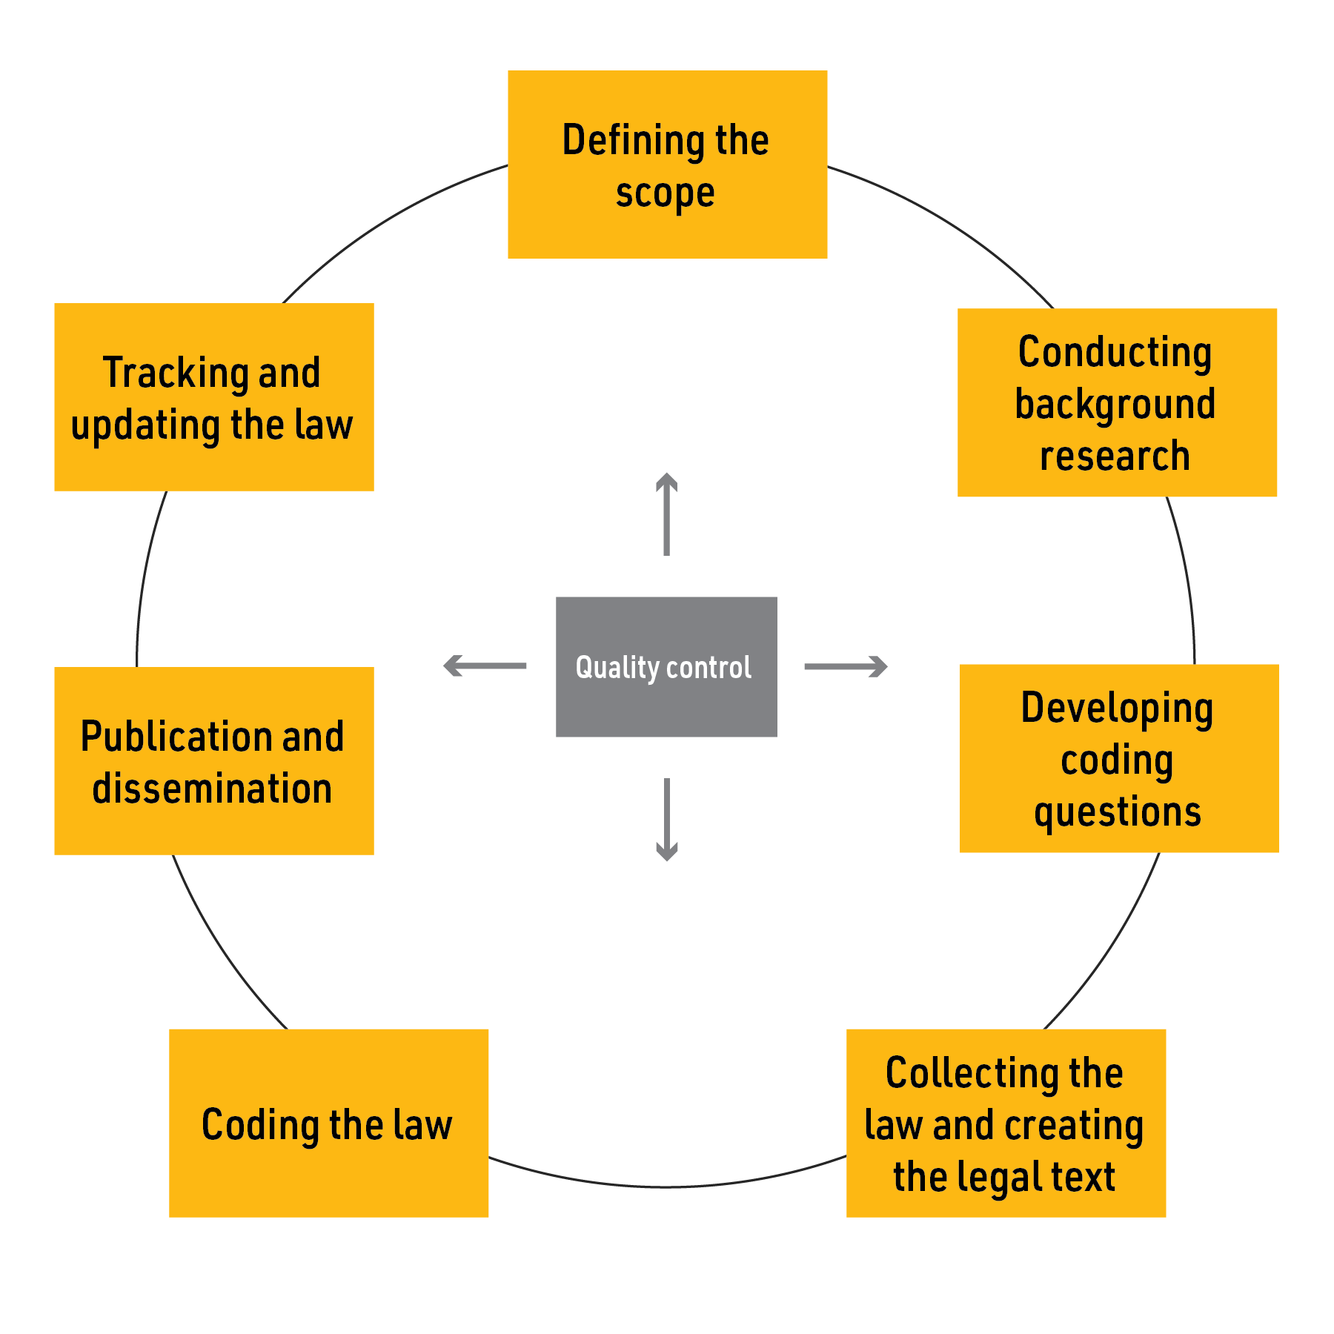
The policy surveillance process – overview
Notes:
Policy surveillance is a nonlinear process. This diagram shows the various steps researchers undergo when they conduct policy surveillance. You can find more information on some of these steps in the Learning Library.
Throughout this module, and the others in the Learning Library, we will use distracted driving laws as an example, and Wendy as our model researcher.
Defining the Scope of the Project, also known as “Scoping”
Determining what will be included in the project is what we call “scoping.” It is the first step of the process, and typically asks the researcher to answer the following questions:
What is the purpose of the project?
What questions is this project looking to answer?
Who is the audience?
Is this project going to be cross-sectional or longitudinal?
For example:
When scoping a project about seatbelt laws, Wendy considers the following:
She wants to learn more about seatbelt laws in all 50 states and the District of Columbia.
She wants this to be a publicly available project.
She decides to do a longitudinal project because she wants to find out when these seatbelt laws were first implemented.
More information about how to define the scope of the project can be found in Module 2.
Conducting Background Research
The second step is to conduct research about the topic and the law available. There are a few things to consider in this step:
Identify sources of legal text. Depending on the subject matter and how specific the research questions are, certain sources of legal text will be more appropriate.
Sources of legal text can include statutes, regulations, case law, policies, rules, etc…
In addition, these sources of legal text can come from governments at the local, state, and federal level, or from private entities.
If the project is cross-sectional, when do you want to take your snapshot?
If the project is longitudinal, what period of time are you interested in? When would it make sense to start and end this project?
For example:
When researching seatbelt laws, Wendy finds that state-level seatbelt laws are contained in state statutes, so decides to use this as the source of legal text. Her research shows that the first state to implement a seatbelt law was New York in 1984, so she decides that her project will start that that year.
More information about conducting background research can be found in Module 2.
Developing coding questions
Identify important elements of the legal text
The research stage can help to identify which elements of the law have the largest influence on outcome data
What questions would be likely to yield variation among the jurisdictions being researched?
For example:
When developing coding questions, Wendy decides to focus her project on whether the states she is reviewing have primary or secondary enforcement and whether these rules apply to the front and/or backseats. Her initial research indicates that there is variation among states on these elements of the law.
More information about how to develop coding questions can be found in Module 3.
Collecting the law
Where will the legal text come from?
Must access to this source be requested/purchased or is it an unencumbered source?
For example:
When collecting the law, Wendy finds that each state has a legislative website which contains the statutes she is interested in, and decides to pull her legal text from these sources because they are unencumbered.
More information about how to collect the law can be found in Module 4.
Coding
Coding is the observation of key words and phrases that indicate whether an element of a law (or the law) exists
The researcher must identify terms of art which are commonly used in the sources of legal text they are collecting, and must document what different language means (using secondary sources to confirm the definitions of words in the law) so that the project can be coded and updated consistently
For example:
Wendy adds her collected law to the legal text in her policy surveillance tool, and codes her research questions based on the statutes in each state.
More information about coding can be found in Module 5.
Publication and Dissemination
How do you want this project to be presented?
Is there any information you would like to highlight?
Audience?
For example:
When publishing, Wendy decides she wants this to be a publicly available project. She chooses to highlight which states have primary enforcement laws for the front seat, because there is a high degree of variation for this element of the legal text.
More information about publication and dissemination can be found in Module 7.
Tracking and updating the law
If the project is longitudinal, how would you like to keep it updated as policies continue to evolve?
Passive updates
A) Setting alerts and periodically checking the law to identify changes as they come in
Active updates
Updating the entire project at regular intervals
For example:
Wendy decides that based on her resources she can do an active update of her project every six months, but sets passive alerts to keep track of new laws as they come in.
More information about tracking and updating the law can be found in Module 8.

Slide 6
Why is policy surveillance important?
Policy Surveillance
Creates legal data for evaluation
Supports the diffusion of innovation
Allows stakeholders to track progress
Builds and Supports workforce legal capacity

Slide 7
What is “legal mapping”?
A process for assessing and capturing important
features and variation in laws and policies, across time and space.
PUBLIC HEALTH LAW PRACTICE
The application of professional legal skills in the development of health policy and the practice of public health.
LEGAL EPIDEMIOLOGY
The scientific study and deployment of law as a factor in the cause, distribution, and prevention of disease and injury in a population.
Legal scan
Legal profile
Policy surveillance
Legal assessments
Notes:
Legal mapping is a set of techniques for capturing important features of laws and policies, and for identifying how they vary across jurisdictions or institutions, and over time. Legal mapping takes many forms. It can be conducted using transparent scientific methods for empirical research in legal epidemiology, or it can rely on conventional legal research methods to answer important questions in multi-jurisdictional public health law practice.
Legal mapping is a broad expression for a process that assesses and captures features of laws and policies. There are multiple ways to perform legal mapping, each with different advantages and disadvantages (see the next slide for more detail). Policy surveillance is one form of legal mapping. If you are unsure about which legal mapping model is right for you, please don’t hesitate to reach out to the Policy Surveillance Program at LawAtlas@temple.edu, and we can discuss your project with you in more detail.

Slide 8
Legal mapping models
 | Mapping model | Type of data produced | Time and place studied | Essential team resources
Legal epidemiology | Policy surveillance | Produces robust data using a rigorous scientific process | Tracks laws over time and across multiple jurisdictions | Team of at least three is required
 | Legal assessments | Produces robust data using a rigorous scientific process | Maps laws at one specific point in time, across multiple jurisdictions | Team of at least three is required
Public health law practice | Legal scan | Quick scan of a topic or domain | Maps laws across multiple jurisdictions at one specific point in time | Can be completed by one person
 | Legal profile | Quick scan of a domain, or multiple domains | Maps laws in one specific jurisdiction at one specific point in time | Can be completed by one person

Slide 9
Summary
Policy surveillance
Tracks public health laws and policies over time and across jurisdictions
Uses a rigorous scientific process to create data for evaluation and empirical research
The policy surveillance process
Defining your scope and background research, question development, collecting and building the law, coding the law, quality control, publication and dissemination, and tracking and updating the law
Policy surveillance: significance
Supports the diffusion of innovation
Allows stakeholders to track progress
Builds policy capacity in the health policy workforce
Creates data suitable for use in rigorous evaluation studies
Legal mapping
Process for assessing and capturing important features and variation across laws and policies
Includes two different models for surveilling laws and policies on a topic
Legal epidemiology vs. public health law practice

