Slide 1
Defining the Scope of the Project and Conducting Background Research
LEARNING LIBRARY
FEBRUARY 2022

Slide 2
Learning objectives
Define “scoping”
Provide an overview of background research
Learn the steps in conducting background research:
Identify reliable secondary sources
Draft a background memorandum
Draft a five state memorandum
Search strategy
Compile a sample of laws relevant to your project
Generate preliminary list of constructs (features of the law)
*Refining the scope throughout

Slide 3
Defining “scoping”
Identifying the topic and parameters for your project
Background research helps define and redefine the scope

Slide 4
Defining and redefining the project scope
The initial scope of the project sets the parameters for what you will study
The scope of the project may change throughout the policy surveillance process
Defining and redefining the scope
Conducting background research
Notes:
One key aspect of background research is identifying the important research questions for your topic. For example, in a project on distracted driving, one important research question you might find is what devices are prohibited while driving in each jurisdiction.
It is important to remember that the scoping process is iterative; it repeats and refines itself. For example, you may collect a sample of laws and realize your team has not discussed whether to focus on just adult drivers, or on adults and minor drivers. The scope of your project will expand or contract throughout the entire policy surveillance process.

Slide 5
From background research to coding questions
Investigate the legal landscape
Identify constructs*
Define preliminary legal
constructs
*Legal constructs are key elements or features of the law that can vary among jurisdictions

Slide 6
Background research
1
Identify reliable secondary sources
Draft a background memorandum to identify key elements of the law and explore the legal landscape on the project’s topic
Draft a five state memorandum to identify variation in the law across a sample set of five states
2
4
Develop a search strategy
3
5
6
Compile a sample of laws relevant to your project
Generate preliminary list of constructs (features of the law)
Refining the scope throughout
Notes:
These are the steps you follow when conducting background research. The following slides will detail these six steps.
A construct is a feature in the law, such as a penalty, a prohibition, or an age restriction.
It is important to note that background research does not simply seek to collect laws, but also to identify important policy questions. For example, in a dataset on distracted driving, it would be important to discuss primary versus secondary enforcement of laws: Can a police officer pull you over merely for breaking a distracted driving law (primary), or can he only pull you over for another violation, and then add on a distracted driving violation (secondary)?

Slide 7
1. Identifying reliable secondary sources
Secondary sources can include:
Articles
Tables
Books
Websites
Legal datasets

Slide 8
2. Draft a background memorandum
Use the secondary sources you identified to summarize the current state of the law
Two researchers will each write a background memorandum that will:
Explore the legal landscape for your project
Identify sources of law (e.g. Statutes, Regulations, Policies) and how they interact
Identify key elements of the laws you are studying
Notes:
Once you have identified some secondary sources, you are ready to write a background memorandum.
A background memorandum is a paper that summarizes and synthesizes the information you’ve uncovered about the legal landscape for a topic.
A background memorandum is also key for acquainting researchers with a topic. This may be a novel topic for one of your researchers, or the law may be more complex than one would expect.
This research will allow you to further explore the legal landscape for your project to identify sources of law and how they interact with each other.
For example, in a distracted driving project, you might find that state statutes and regulations dictate distracted driving law in each state.
You may also find that every state but Montana has a law on using a cellphone while driving, while only 36 states have a law on minors using a cellphone while driving.
You will also be able to identify key elements of the laws you are studying while performing your background memorandum, by identifying what areas of the law are evolving, as well as what elements of the law are present in most jurisdictions you will be studying.
To write a background memorandum:
Assign two researchers to independently write a background memorandum on the same topic. By assigning two researchers, we increase the likelihood that important details and trends will not be missed. These trends and details are helpful in continuing to redefine the scope of the project.
The background memorandum should:
Explore the legal landscape of the topic
Identify sources of law and how they interact
Identify key elements of the laws
For an example of a background memorandum please see the related resources section of module 2.

Slide 9
3. Draft a five state memorandum
Two researchers will research five states (or jurisdictions) each for an initial sample of 10 states
Goals:
Identify source and structure of the law
Present a sample of laws relevant to your topic
Identify variation in the law
Notes:
After writing your background memorandum, you are ready to write a Five State Memorandum. A Five State Memorandum is a document that summarizes laws in five jurisdictions that are relevant to the project’s topic.
We use the term Five State Memorandum, but you can collect law from cities, countries, hospital policies, emergency acts, case law, etc. This step allows you to dive deeper into the legal landscape in a sample of jurisdictions to see variation and nuance.
Two researchers will be assigned five states each for a total sample of 10 states. A Five State Memorandum starts to look at specific laws that are relevant to your topic with several goals:
Identify source and structure of the law:
With distracted driving, for example, the following types of laws can be collected:
State Statutes
State Regulations
Local ordinances
Formal policies at a school or business
Historical statutes and regulations
Present a sample of laws relevant to your topic
After identifying the sources of law that can be collected for each jurisdiction, you can present a sample of relevant laws for each of the 5 jurisdictions.
And most importantly, compare the samples of relevant laws in these five jurisdictions to identify variation in the law
At the end of your Five State Memorandum, you should compare what the law said in each jurisdiction about important elements of the law with what you identified in your background memorandum. This will help you to identify variations in the law.

Slide 10
4. Search strategy
Using multiple search strategies ensures reliable and accurate legal research (e.g. using different search terms, table of content searches, multiple databases)
Adopt measures to minimizer errors in search strategy
Record strategies in a research protocol document
Notes:
A search strategy consists of the search terms, databases used, and strategies to be employed by the researchers working on a Policy Surveillance Project.
We go into each step in more detail in the following slides.

Slide 11
4. Search strategy
Use multiple search strategies to ensure reliable and accurate legal research
Identify keywords by identifying common terms of art relevant to the project’s topic in various jurisdictions
When multiple relevant laws are located in the same chapter, index or table of content searches can be used to supplement keyword searches
Multiple databases should be used to ensure accuracy, such as Westlaw, LexisNexis, Bloomberg, or HeinOnline
Notes:
Keyword searches
For example, in a distracted driving project, you will want to search for laws that mention cell phones. It will be useful to come up with a list of different ways the law says, “cell phones”, such as:
“wireless telephone”
“mobile communication device”
“cellular phone”
You will also want to explore whether it is a viable option to use the table of contents to search for the law you are interested in. For example, most of the law relevant to registered nurse scope of practice can be found in the Nurse Practice Act. Therefore, a good starting point for searching for law on that project would be to explore the nurse practice act in each jurisdiction.
Measures adopted to minimize error should be included in the search strategy. One state such as Oregon in our example above may have all of the relevant legal text we need to study in one law, whereas in California you need to look at 3 different laws to find the same information.
Searches must be recorded in a research protocol document, see our related resources in Module 2 for a research protocol template.

Slide 12
4. Search strategy
Adopt measures to minimize errors in search strategy
Some jurisdictions may structure their law differently from others, necessitating different search strategies
OR. Stat. § 98:2-12.5:
Prohibition
Exceptions
Fine
CA. § 921
Prohibition
Exceptions
CA. § 811
Enforcement
CA. § 153.018
Fine
Notes:
Keyword searches
For example, in a distracted driving project, you will want to search for laws that mention cell phones. It will be useful to come up with a list of different ways the law says, “cell phones”, such as:
“wireless telephone”
“mobile communication device”
“cellular phone”
You will also want to explore whether it is a viable option to use the table of contents to search for the law you are interested in. For example, most of the law relevant to registered nurse scope of practice can be found in the Nurse Practice Act. Therefore, a good starting point for searching for law on that project would be to explore the nurse practice act in each jurisdiction.
Measures adopted to minimize error should be included in the search strategy. One state such as Oregon in our example above may have all of the relevant legal text we need to study in one law, whereas in California you need to look at 3 different laws to find the same information.
Searches must be recorded in a research protocol document, see our related resources in Module 2 for a research protocol template.

Slide 13
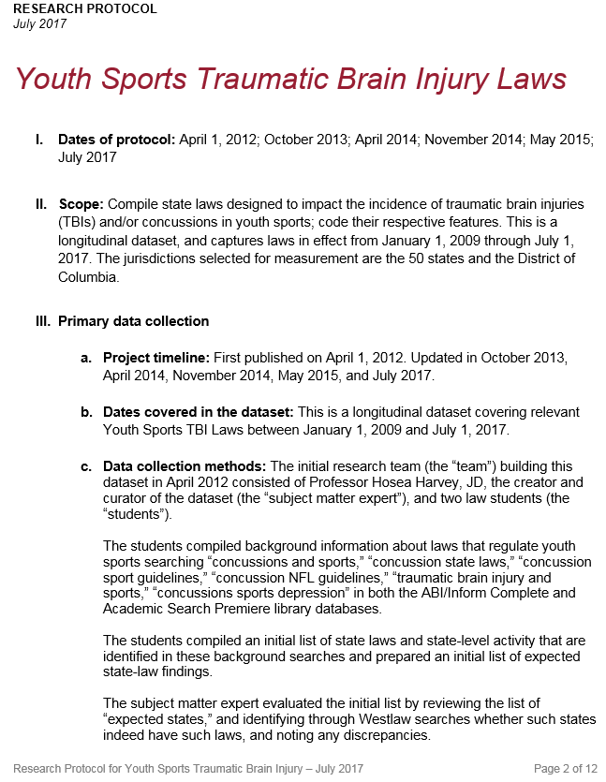
4. Search strategy
Record all search terms and strategies in a research protocol document
A research protocol describes the methodology for a project, including scoping decisions, search terms and connectors used, and other key information
Easier to maintain and update the project as laws change
Supports future replication by other researchers as methodology is detailed in protocol
Notes:
Searches must be recorded in a research protocol document, see our related resources in Module 2 for a research protocol template.
A research protocol document is one which describes the methodology for a project, including scoping decisions, search terms and connectors used, and other key information. More on the research protocol can be found in Module 7, publication and dissemination.
Under related resources in Module 7, publication and dissemination, you can find a template for the research protocol which can guide you in creating one

Slide 14
5. Compile a sample of laws
Researchers will collect a sample of laws for each of the five jurisdictions assigned for the five state memorandum
Kentucky
Oklahoma
California
Oregon
Missouri
Notes:
Researchers can collect the sample by researching important features of the law in the Five State Memorandum. It is also a good idea to record each relevant legal citation within the Five State Memorandum.
Each researcher working on the project will evaluate five jurisdictions in this step. If there are two researchers involved in the project, two Five State Memorandums will be produced for a total of 10 states.
Looking at important features of the law collected in the Five State Memorandum allows the project team to draft questions later in the process. This step also gives the research team an idea of how the laws on the project topic are structured.
For an example of a Five State Memorandum, please see the related resources within Module 2.

Slide 15
6. Generate a preliminary list of constructs
“Constructs” are features of the law that are relevant to your project’s topic
In a distracted driving project, constructs could include what devices are prohibited while driving, what behavior is prohibited while driving, and whether there are exceptions to these prohibitions
Notes:
Constructs are converted into questions in Module 3, which are then answered in the jurisdictions that are being studied

Slide 16
Generating constructs
Compare elements of the law in each state from your Five State memorandum
Contact subject matter experts
The constructs you use will be based on apparent features of the legal text, so that coding requires as little interpretation as possible.
REMEMBER: Policy surveillance aims to measure the law, not interpret it.

Slide 17
Generating preliminary constructs list
ORIGINAL TEXT OF THE LAW
Ala. Code § 32-5A-350(b): A person may not operate a motor vehicle on a public road, street, or highway in Alabama while using a wireless telecommunication device to write, send, or read a text-based communication.
PRELIMINARY CONSTRUCT
Text messaging prohibited while driving
Ohio Rev. Code § 4511.204(A): No person shall drive a motor vehicle, trackless trolley, or streetcar on any street, highway, or property open to the public for vehicular traffic while using a handheld electronic wireless communications device to write, send, or read a text-based communication.
Notes:
Above is an example of two laws, and the construct which can be derived from them.

Slide 18
Summary: Defining the scope
Defining the scope of your project consists of:
Identifying the statement of purpose for your project
What is your topic
What are your goals
Setting clear parameters for what you will and will not study
Defining what law will have to be collected
Scoping is an iterative process that can expand and contract throughout the life of your project

Slide 19
Summary: Background research
Background research consists of:
Identifying secondary sources
Using the secondary sources you identified to draft a background memorandum to explore the legal landscape for your project
Drafting a five state memorandum, presenting a sample of laws relevant to your topic to identify structure and variation in the law
Developing a search strategy
Multiple search strategies should be used
Searches should be recorded in a research protocol
Compile a sample of laws
Identifying preliminary constructs (features of the law)
Background research helps to develop and refine the scope of your project

