Slide 1
Collecting the Law
LEARNING LIBRARY
FEBRUARY 2022

Slide 2
Learning objective
Refine citations collected during Five State Memorandum
Define “collecting the law”
Learn the steps to collect the law
  Identify relevant laws
  Record citations on Master Sheet
  Collect individual laws using citations on Master Sheets
  Organize law into folders
  Transfer and combine collected laws into legal text document
  Create an amendment tracker (policy surveillance only)
  Use amendment trackers to create one version of the legal text per change in the law over time (policy surveillance only)

Slide 3
Collecting the law
Identify relevant laws
Create the legal text
Record citations on Master Sheet
Repeat this cycle with batches of 10 jurisdictions
Organize laws into folders
Collect individual laws

Slide 4
Refine citations collected during
Five State Memorandum
Two researchers have collected relevant citations for 10 jurisdictions in their Five State Memorandum
Since the Five State Memorandum is written before finalizing coding questions, those citations must be refined as the scope is refined
  Refine those citations by adding or removing relevant citations, based on the current scope of the project

Slide 5
Learn the steps to collect the law
1
  Identify relevant laws
2
  Record the research strategy
3
  Collect individual laws using citations on Master Sheets
4
  Organize law into folders
5
  Transfer and combine collected laws into legal text document
6
  Create an amendment tracker
7
  Use amendment trackers to create one version of the legal text per change in the law over time
Notes:
Steps:
Identify relevant laws
Record citations on Master Sheet (Create a master sheet; Organize citations hierarchically; Organize citations chronologically for policy surveillance projects; Record research strategy on Daily Research Sheet)
Collect individual laws using citations on Master Sheets
Organize law into folders
Transfer and combine collected laws into legal text document
Create an amendment tracker (policy surveillance only)
Use amendment trackers to create one version of the legal text per change in the law over time (policy surveillance only)

Slide 6
1. Identify relevant laws
Researchers begin by using the search strategy established during their background research to identify laws relevant to their topic in each jurisdiction
Then, they record the citations of relevant laws in a Master Sheet document
Notes:
For more information on creating a search strategy, see Module 2, Defining your Scope and Background Research

Slide 7
2. Record the research strategy
A “Daily Research Sheet” is used to record search terms and strategies as research is being conducted
The Daily Research Sheet should include the following information
  Database used to perform research
  Search terms used
  Results yielded from searches
  Notes on the search strategy used
Daily Research Sheet
Alaska | Search terms Number of results Relevant citations
Research Resource: Westlaw Notes: Used “Statute & Court Rules” to find West’s Alaska Statutes Annotated database; used “Regulations” to find AK regulations. | Distracted driving 50 statutes, 50 regulations wireless device AND driving 51 statutes, 50 regulations texting AND driving 52 statutes, 50 regulations school bus 61 statutes, 52 regulations Citations collected: Alaska Stat. § 12.55.035. Fines; Alaska Stat. § 12.55.135. Sentences of imprisonment for misdemeanors; Alaska Stat. § 28.01.010. Provisions uniform throughout state; Alaska Stat. § 28.35.161. Use of electronic devices while driving; unlawful installation of television, monitor, or similar device
Notes:
A Daily Research Sheet is a document that researchers use to keep track of the search terms that were used to collect law for each jurisdiction, and what databases were used to make these searches. It should also include information on how many results each search yielded, what laws were collected by each search, and general notes on what is and is not working in the search strategy. You can find a template of our Daily Research Sheet under related resources for this module in the Learning Library at LawAtlas.org.

Slide 8
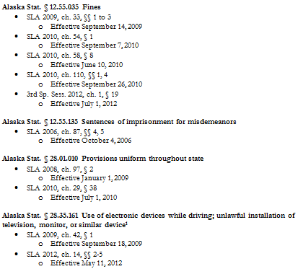
What is a Master Sheet?
A “Master Sheet” records citations of laws that are in the project’s scope, with one Master Sheet per jurisdiction
ALASKA MASTER SHEET

Slide 9
What is a Master Sheet?
ALASKA MASTER SHEET
A “Master Sheet” records citations of laws that are in the project’s scope, with one Master Sheet per jurisdiction
Notes:
The slide includes a sample of one law in a Master Sheet for Alaska, using distracted driving law as the example.

Slide 10
Creating a Master Sheet:
Recording citations of relevant laws
Master Sheet should include:
  The citation and title of each law
  The statutory history for each law
  And the effective dates
Alaska Master Sheet
Alaska Stat. § 12.55.035 Fines
3rd Sp. Sess. 2012, ch.1, § 19
        Effective July 1, 2012
SLA 2016, ch. 36 § 72
        Effective October 9, 2016
Notes:
It is important to keep a document that keeps track of all the laws being collected, as well as key information on these laws, to facilitate the rest of the research and coding process. This document is called a Master Sheet.

Slide 11
Organizing citations hierarchically
Sort the laws in the Master Sheets by organizing them hierarchically
  By jurisdiction (federal, state, local)
  By type of law (statute, regulation, ordinance)
  By chapter and citation number (12.55.135 comes before 12.55.150)
State Statutes
State Regulations
Federal Regulations
Local Ordinances
Federal Statutes
Notes:
The next step in collecting the law consists of organizing it first hierarchically. This step applies to both policy surveillance and legal assessment.

Slide 12
Organizing citations chronologically for longitudinal projects
Collecting the law for policy surveillance (longitudinal) projects includes organizing laws hierarchically as you would in a legal epidemiology project, and then organizing them in chronological order to show how a law has changed in a jurisdiction over time.
Sept. 18, 2009 version of law
May 11, 2012 version of law
Notes:
A policy surveillance project is one which tracks the evolution of laws over time, whereas a legal assessment project shows the state of the law at a point in time.

Slide 13
4. Organize the law into folders
Each jurisdiction should have its own folder that contains documents relevant to that jurisdiction, including:
Collected laws
The Master Sheet
The Amendment Tracker
Alaska Folder
Notes:
The first step in building the law involves organizing the law into folders.
Keeping documents organized by jurisdiction will make it easier to prepare for coding, and will allow the supervisor to perform quality control more efficiently.
For more information on master sheets, amendment trackers and legal text, please see the next slides.
Now that you have organized the law into folders, you are ready to organize the law hierarchically.
The amendment tracker facilitates creating the legal text for policy surveillance projects.

Slide 14
5. Transfer and combine collected laws into legal text document
The “legal text” is the organized version of the relevant law for a jurisdiction:
Legal assessment (cross-sectional) – one legal text, for one jurisdiction, at one point in time
Policy surveillance (longitudinal) – multiple legal texts, for one jurisdiction, over a period of time
The legal text is used to code the law

Slide 15
Transfer and combine collected laws into legal text document
MASTER SHEET CITATIONS
FULL TEXT ORDERED HIERARCHICALLY
IN ONE DOCUMENT
Alaska Stat. § 12.55.035 Fines
3rd Sp. Sess. 2012, ch. 1, § 19
  Effective July 1, 2012
Alaska Stat. § 12.55.135 Sentences of imprisonment for misdemeanors
SLA 2006, ch. 87, §§ 4, 5
  Effective October 4, 2006
Alaska Stat. § 12.55.035 Fines (2012 Amendment, 3rd Sp. Sess. 2012, ch. 1, § 19)
Upon conviction of an offense, a defendant may be sentenced to pay a fine as authorized in this section or as otherwise authorized by law……
Alaska Stat. § 12.55.135 Sentences of imprisonment for misdemeanors (2006 Amendment, SLA 2006, ch. 87, §§ 4, 5)
A defendant convicted of a class A misdemeanor may be sentenced to a definite term of imprisonment of not more than one year……
Notes:
The final step in this stage of the process is to transfer the collected law into one document with the legal text per jurisdiction to match the newly organized Master Sheet.
For legal assessments, remember that you need one document for each jurisdiction that includes all the relevant laws in one jurisdiction, at a specific point in time, organized by hierarchy.
In the above example coming from a distracted driving project for Alaska, the researcher would like to create the first iteration containing the legal text.
The project aims to measure the law on January 1, 2013, so the researcher will need the version of the law that was effective on that date.
The first statute is Alaska Stat. § 12.55.035, and was most recently amended on July 1, 2012, so this version of the law is required for a snapshot of the law on January 1, 2013
The second statute is Alaska Stat. § 12.55.135, and was most recently amended on October 4, 2006, so this version of the law is required for a snapshot of the law on January 1, 2013.

Slide 16
6. Create an Amendment Tracker
The “Amendment Tracker” document
Lists amendments to relevant laws in one jurisdiction, in chronological order
Created to serve as a guide when creating the legal text for a policy surveillance project
Notes:
Amendment Tracker documents are important for building policy surveillance projects, because they show the progression of the law in a specific jurisdiction. Amendment Trackers list amendments to relevant laws in one jurisdiction in chronological order. You will have one Amendment Tracker for every jurisdiction included in the project.
They include the effective dates for each amendment, and descriptions of the changes made in each amendment.
Each entry in the Amendment Tracker reflects one version of the law that must be collected, built and coded in order to measure the law across the time period included in the project.
The next slide includes a sample of an Amendment Tracker used in a distracted driving laws project.

Slide 17
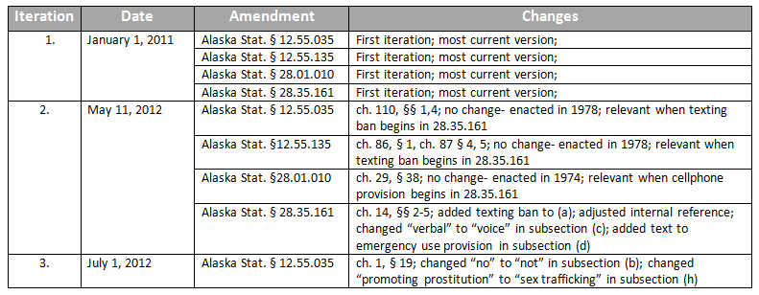
Creating an Amendment Tracker
Notes:
Amendment Trackers contain the following information:
Iteration number: This indicates the iteration of the law. An iteration is a set of specific provisions that constitute the relevant law for a given jurisdiction and time period. Every time any provision for a jurisdiction changes, a new iteration must be created. For example, if Alaska has four statutes for a topic, and one changes, a new iteration must be made. Likewise, if a relevant law in a jurisdiction is added or removed, a new iteration must be created.
The first iteration is always the start date of the project. In the example above, the project is tracking distracted driving laws beginning on January 1, 2011. Any subsequent iterations represent amendments to relevant laws that occurred after the start date. For example, the second iteration is on May 11, 2012, because a relevant law was amended with that effective date being May 11, 2012.
Date: This designates the effective date for the amendment you are describing. The effective date is the date the legislation becomes effective, not the passage date, or the signature date.
Amendment: This section includes the citation for the law that is being amended on that date.
Changes: This section indicates the nature of the change. Including detailed information about the nature of the change will make coding the law easier. This information can be obtained by reading the legal text and the statutory history notes.
For more information on creating an Amendment Tracker, see “How to Build an Amendment Tracker” under related resources.
Now that the law is organized hierarchically, and chronologically for policy surveillance projects, it is time to create the legal text which will be used to code.

Slide 18
7. Use amendment trackers to create one version of the legal text per change in the law over time
MASTER SHEET CITATIONS
FULL LEGAL TEXT FOR MAY 11, 2012
Alaska Stat. § 12.55.035 Fines
SLA 2010, ch. 110, §§ 1, 4
  Effective September 26, 2010
3rd Sp. Sess. 2012, ch. 1, § 19
  Effective July 1, 2012
Alaska Stat. § 28.01.010 Provisions uniform throughout state
SLA 2010, ch. 29, § 38
  Effective July 1, 2010
Alaska Stat. § 28.35.161 Use of electronic devices while driving; unlawful installation of television, monitor, or similar device
SLA 2009, ch. 42, § 1
  Effective September 18, 2009
SLA 2012, ch. 14, §§ 2-5
  Effective May 11, 2012
Alaska Stat. § 12.55.035 Fines (no changes)
Upon conviction of an offense, a defendant may be sentenced to pay a fine as authorized in this section or as otherwise authorized by law…..
Alaska Stat. § 28.01.010 Provisions uniform throughout state (no changes)
The provisions of this title and the regulations adopted under this title are applicable within all municipalities of the state.…..
Alaska Stat. § 28.35.161 Use of electronic devices while driving; unlawful installation of television, monitor, or similar device (2012 Amendment, ch. 14 §§ 2-5)
A person commits the crime of driving while texting, while communicating on a computer, or while a screen device is operating if the person is driving a motor vehicle, and……
AMENDMENT TRACKER
Iteration | Date | Amendment | Changes
2. | May 11, 2012 | Alaska Stat. § 28.35.161 | ch. 14, §§ 2-5; added texting ban to (a); adjusted internal reference; changed “verbal” to “voice” in subsection (c); added text to emergency use provision in subsection (d)
Notes:
This example is a demonstration of how we use the Master Sheet and Amendment Tracker together to create the legal text, to show the evolution of law over time in a Policy Surveillance project.

Slide 19
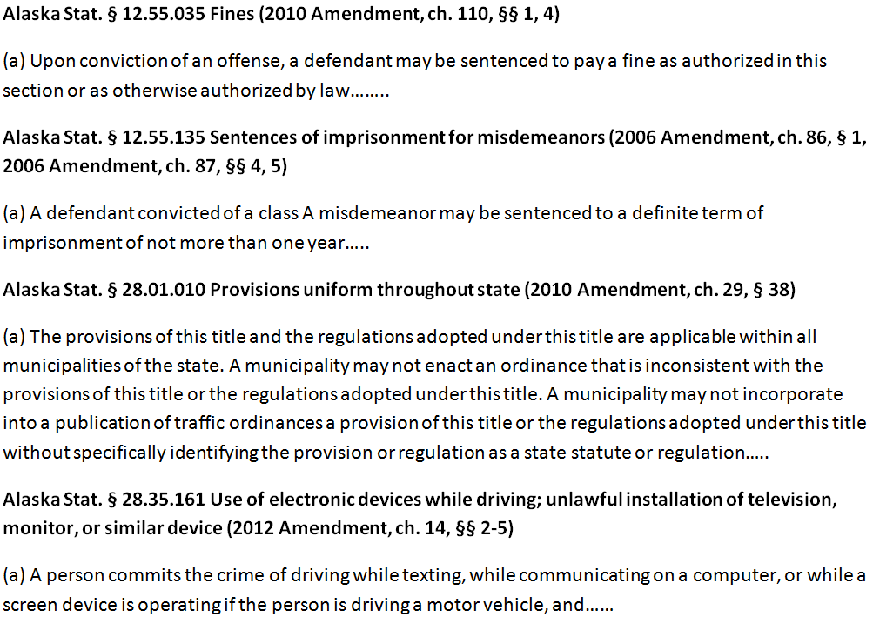
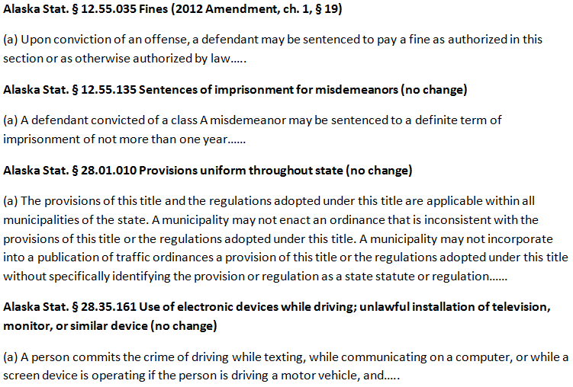
Using an amendment tracker to create the legal text
MAY 11, 2012 VERSION
JULY 1, 2012 VERSION
Notes:
In the above example, we are using a distracted driving project. Please note that this slide does not contain the full legal text, but extracts of the legal text for the purposes of demonstration.
Using our Amendment Tracker (slide 18), we know that Alaska Stat. 12.55.035 Fines was amended effective July 1, 2012. That means that a new version of the legal text must be created.
To create the July 1, 2012 legal text, follow these steps:
Use the Amendment Tracker to confirm the changes to the laws.
Open the previous version of the legal text, in this case, May 11, 2012.
“Save As” or otherwise duplicate the entire document.
Find the law that has changed.
Make the edits to the law.
Save the new version of the legal text using the iteration date.
The outcome is a snapshot of what all relevant laws looked like in Alaska on July 1, 2012.
**You can see that the legal text on July 1, 2012 and May 11, 2012 are nearly identical, except for Alaska Stat. § 12.55.035 Fines, which is updated based on its amendment on July 1, 2012.

Slide 20
Most commercial legal databases (e.g., Lexis, Westlaw) impose contractual limits on users’ rights to store and republish laws obtained from the database.
See LawAtlas.org for more information on obtaining or creating open-source legal text for use in LawAtlas datasets.
Notes:
No legal text obtained under such a license may be stored or published on LawAtlas

Slide 21
Users who are collecting laws should carefully review the terms of service from the legal database they use.
State legislative websites typically have a section which indicates any copyright restrictions which apply to using law listed on their sites.
Notes:
No legal text obtained under such a license may be stored or published on LawAtlas

Slide 22
Summary
Prior to collecting the law, refine citations collected during five stat memo based on the current scope of the project
“Collecting the law” consists of researchers finding and gathering important information about laws relevant to a topic in each jurisdiction being studied
The steps required to collect the laws are:
  Identify relevant laws
  Record citations on Master Sheet
  Collect individual laws using citations on Master Sheets
  Organize law into folders
  Transfer and combine collected laws into legal text document
  Create an amendment tracker (policy surveillance only)
  Use amendment trackers to create one version of the legal text per change in the law over time (policy surveillance only)

