Slide 1
Quality Control
Coding
LEARNING LIBRARY
FEBRUARY 2022

Slide 2
Learning objectives
Learn how to perform quality control on original coding
Define “redundant coding”
  Learn the steps used in redundant coding
Define ”naïve coding”
  Learn the steps used in naïve coding
Learn how to do a final quality control check
Notes:
Original coding consists of using the legal text collected to answer the questions developed. For more information on coding, please see Module 5, coding.
Redundant Coding
Assign sufficient redundant coding to ensure the coding scheme is thorough and the coding is accurate
Calculate a rate of divergence
Complete a redundant coding review and determine the reason for divergences
Determine when a divergence requires a change in the coding scheme
Naïve coding
Understand when to assign naïve coding
Complete a naïve coding review and determine the reason for divergences
Determine when naïve coding requires the execution of a resolution plan
Coding review
Divergence calculation

Slide 3
How to perform quality control on original coding
As records are coded, the supervisor will check the following:
  Unanswered questions
  Caution notes
  Citations
  Formatting issues with the legal text
Original coding checks occur daily, as researchers are coding records
Notes:
Original coding = When a researcher initially codes a jurisdiction for a project, before it is redundantly coded.
Issues with the legal text: Adding indents and spacing
Ensuring that no additional text other than the law is in the legal text
For example, if the researcher had any notes in their original legal text, these notes have to be removed before being added to the system being used to code, so that only the text of the law appears.
Missed questions:
Check whether any questions were not answered, either because they were missed or a child/grandchild question
Caution notes:
Read through caution notes for any issues that might be addressed to the supervisor, e.g., regarding the coding scheme or a question in particular
For example, researchers may have added caution notes when there is a response in the law which does not exist on the project’s response set. The supervisor can then decide to either keep the caution note or add a new response.
Citations:
Ensuring that there is a citation corresponding to each response, and that citations are correctly written.

Slide 4
Define “redundant coding”
“Redundant coding” consists of two researchers independently coding identical coding records
  The supervisor compares and reviews these records to determine where the researchers diverge
Redundant coding identifies:
  Problems with the questions
  Problems with the response set
  Coding errors
Notes:
For more information on coding specifically, please visit Module 5, “Coding the Law.”
As the researchers continue redundant research to ensure all the citations within the jurisdictions are included, researchers will also redundantly code those same jurisdictions to ensure all questions have been answered correctly.
Redundant coding consists of two researchers independently coding identical records form the same jurisdiction.

Slide 5
Steps in redundant coding
Researchers code records
3
Supervisor reviews redundant coding
2
4
Team resolves divergences
1
Supervisor assigns redundant coding
Notes:
Redundant coding is when you assign the same entry to two different coders. Redundant coding is important because it helps the supervisor identify errors in the data and coding scheme. When at least two researchers concur independently on coding decisions, it suggests that the coding questions and instructions were sufficiently clear and detailed and that the researchers were well trained. If the researchers code different answers for the same question, it can indicate that the question is vague or requires interpretation and needs to be revised. It could also mean that the researchers need additional training or instruction.
Steps
This slide is a roadmap of the steps involved in the redundant coding process. The next slides will explain each step in further detail.

Slide 6
1. Assigning redundant coding
The supervisor assigns 100% redundant coding until the rate of divergence is below 5%
  When the rate of divergence goes below 5%, the supervisor assigns 20% redundant coding
    The supervisor may assign additional redundant coding as needed
Divergences are recorded on a Coding Review Sheet, a document allowing researchers to explain their coding decisions in the case of a divergence
Notes:
To make assigning and reviewing redundant coding easier, we suggest that you include a coder name field in any of your datasets, to identify which coder coded what responses.
For example, if there are 50 jurisdictions being studied in a cross-sectional project, with batches of 10 jurisdictions at a time being assigned, the first 10 jurisdictions should all have redundant coding (100% * 10 jurisdictions). If the rate of divergence for that batch is below 5%, then only 2 of the following 10 jurisdictions (20% * 10 jurisdictions) should have redundant coding.
For a longitudinal project, redundant research is performed on a set percentage of total iterations for a batch. So when the rate of divergence is above 5% and a batch of 10 jurisdictions has an average of 5 iterations per jurisdiction, then all 50 iterations must be redundantly coded (100% * 10 jurisdictions * 5 iterations per jurisdiction). However, if the rate of divergence goes under 5%, then 10 iterations must be redundantly coded (20% * 10 jurisdictions * 5 iterations per jurisdiction)
For more information on calculating the rate of divergence, please see our supporting document, “calculating the rate of divergence.”
Determining the rate of divergence
We recommend assigning 100% redundant coding when you begin the coding process. More redundant coding should be assigned at earlier points in the process to identify errors in the coding scheme, and to avoid issues later in the process.
If the rate of divergence is satisfactory, 20% of the remaining number of records should be redundantly coded.
If the rate of divergence is great than 10%, 100% of redundant coding should be assigned until the rate reduces to less than 10%

Slide 7
2. Researcher code records
Researcher 1
Code law
R1 divergences
Identical responses
Researcher 2
Code law
R2 divergences
Notes:
The first step in redundant coding consists of the supervisor assigning jurisdictions to the researchers to be coded. For more information on coding specifically, please visit Module 5, Coding the Law. For redundant coding to be effective, the researchers must code the records independently without speaking with the other researcher. Therefore, it is important that the system is set up in a manner where the researchers cannot see the other researchers responses until the coding is complete.
As researchers code the same jurisdiction, they will overlap on some responses, but will diverge on other responses. The objective is to identify which responses were divergent and to resolve those divergences.
Longitudinal redundant coding
For longitudinal datasets, redundant coding must be done by iteration, rather than by jurisdiction. If a longitudinal dataset has 10 iterations per jurisdiction for the first 10 jurisdictions, this means that 100 iterations are available to be redundantly coded (10 jurisdictions multiplied by 10 iterations). If the project requires 20% redundant coding, this means 20 iterations must be redundantly coded. However if a project requires 100% redundant coding, all 100 iterations must be redundantly coded.
Divergences in one iteration should be resolved for iterations that take place afterwards, because it can be assumed that if researchers diverged on a response in an earlier iteration, they are likely to diverge on the same response in a later iteration for the same jurisdiction
A longitudinal study tracks the evolution of laws over a period of time, whereas a cross-sectional study which takes a snapshot of the law at a point in time.

Slide 8
3. Supervisor reviews redundant coding
Calculate the rate of divergence
Record divergences and errors in a Coding Review Sheet and send notes to researchers
Notes:
For an example and template of a coding review sheet, please visit the related resources under Module 6, quality control.
Once researchers have redundantly coded each other’s jurisdictions, the supervisor must compare the responses that the researchers submitted and determine which responses diverged.
Next, the supervisor should calculate the rate of divergence, meaning what percentage of responses the researchers disagreed or diverged on. A low rate of divergence generally indicates that less redundant coding can be assigned in the future, whereas a high rate of divergence means that more redundant coding is required to ensure quality.
The supervisor should then record these divergences in a coding review form, and send this form to both researchers. The researchers should then look at each divergent response and explain in the coding review form why they chose their response.
A template of our coding review form and a worksheet to help you calculate the rate of divergence are available for download under “Templates”

Slide 9
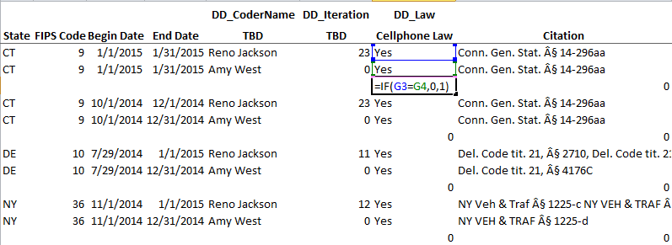
Calculate rate of divergence
The rate of divergence is calculated by dividing the total number of divergences in a batch of jurisdictions (numerator) by the total number of coded variables (denominator).
Notes:
To calculate the rate of divergence, you divide the total number of divergences in each batch of coding by the total number of coded variables. This can be done using formulas in Microsoft Excel. For a guide to calculating a divergence, please refer our step-by-step guide in the resources section of the Module 6 webpage to calculating a rate of divergence, “Calculating the Rate of Divergence.”
Once the rate of divergence is calculated, you should record it on the Coding Review Sheet (see next slide for detail). The amount of redundant coding you assign in the next batch of coding depends on the rate of divergence. At the beginning of the project, the rate may be high because the coding scheme has not been sufficiently tested, and the coders are new to the project and the law. But, the rate of divergence should decline with each batch of coding assigned.

Slide 10
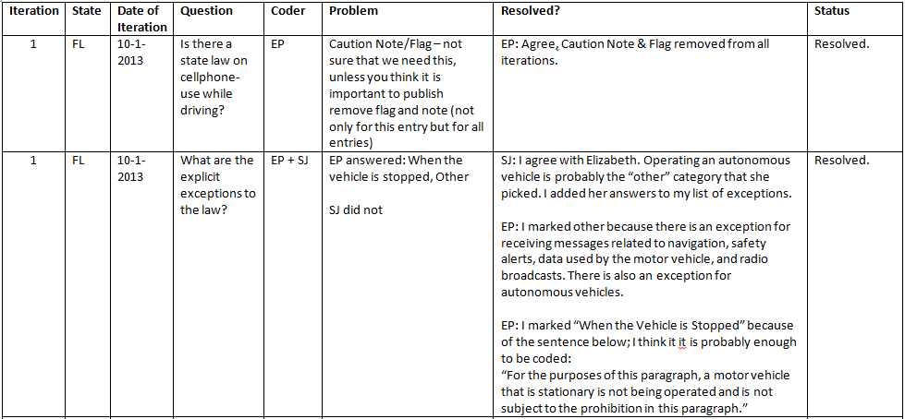
Record divergences and errors in a coding review sheet
Jurisdiction
Question
Supervisor comments
Researcher comments
Date of iteration
Iteration
Researcher
Status

Slide 11
4. Determine reason for divergence
Two types of divergences can occur:
  Objective: instances where one coder answered the question incorrectly
  Interpretive: instances where the coders disagreed on a response based on a different interpretation of the law or of the question
Notes:
Once the overall rate of divergence has been calculated, the next step is to classify the errors in the data. Generally, divergences will fall into one of two categories: objective errors or interpretive errors.
Objective errors: instances when the original coder or the naïve coder answered the question incorrectly. This could be because the coder forgot to answer a question, because of a typo, or because the coder misread a law.
Interpretive errors: errors where the coders reasonably came to different conclusions based on a different interpretation of the law. This could happen if two coders defined a key term differently, or if the coding scheme is not yet well defined.

Slide 12
Resolve divergences
When there is an objective error, the response should be recoded
If a researcher is frequently making objective errors, additional training may be necessary
When there is an interpretive error, the are several potential resolutions:
Modify question
Collect additional law
Edit response set
Researchers work on the Coding Review Sheet independently and may agree or disagree on a response after revisiting the question
The team meets to discuss and resolve any outstanding divergences
Researchers recode all of their original jurisdictions, as needed
Notes:
Questions can be modified when an unclear question is frequently causing interpretive errors.
Additional laws can be collected if they clarify an issue that is causing a divergence.
When a decision has been made about how to interpret a question or responses, it should be recorded in the research protocol document. For more information on the research protocol, please see Module 7, “Publication and Dissemination”.
When there is a decision made relating to coding, it should be added to the research protocol.
Edit response set – When editing responses to resolve an interpretive error, new responses can be added based on responses identified in legal text, or the language used for responses can be adjusted for additional clarity.
This meeting can take place in person or remotely, depending on whether the researchers are working from the same location.
If a decision was made during original coding that affects previous jurisdictions, researchers have to recode those jurisdictions
Conducting quality control on a rolling basis as research is being performed (in batches of 10 states at a time) allows early issues to be rectified before the entirety of a project’s research is complete. This also serves to educate the researchers on the complexities of the project, so that later research is facilitated. Initially, there should be a great deal of discussion and quality control, and as divergences are addressed it should become faster and more efficient.

Slide 13
Define “naïve coding”
A researcher who is naïve to the project codes 20% of the total number of records
  The supervisor compares and reviews these records to determine where the researchers diverge
Naïve coding:
  Ensures that the project is replicable
  Increases the accuracy of the project with additional quality control
Notes:
Naïve coding happens at the very end of the research process, when the coding scheme is well defined and questions and answers are finalized.
For more information on coding specifically, please visit Module 5, Coding the Law.

Slide 14
Steps in naïve coding
Supervisor reviews naïve coding
Supervisor assigns naïve coding
Team resolves divergences
Notes:
The process for Naïve coding is nearly identical to the process for redundant coding. The naïve researcher codes 20% of records for the project. Then the supervisor compares the naïve researcher’s responses to the final responses for the project. Finally, the supervisor resolves divergences by meeting with the researchers.

Slide 15
1. Assigning naïve coding
As coding nears completion, the supervisor assigns a naïve coder to code 20% of the total number of records
  These records are assigned at random
The naïve coder reviews the research protocol and background research prior to coding
Notes:
A naïve coder will be assigned a percentage of the total records coded. Generally, 20% of the total records is sufficient to assess the overall quality of the dataset.
A majority of original coding means that at least 80% of coding has been completed for the project.

Slide 16
2. Supervisor reviews naïve coding
Calculate the rate of divergence
Record divergences and errors in a Coding Review Sheet and send notes to researchers
Notes:
The supervisor should then review naïve coding in the same way that he reviewed redundant coding. A rate of divergence should be calculated, then divergences should be sent to the naïve researcher and the original researcher in a coding review sheet. The researchers should write comments in the coding review sheet to explain their responses. Finally, researchers should meet with the supervisor to discuss outstanding divergences. Please see our supporting document, “How to Calculate the Rate of Divergence” for more information.
The researchers should then look at each divergent response and explain in the coding review form why they chose their response.

Slide 17
3. Resolve divergences
Objective errors are to be expected at a higher rate for naïve coding than for redundant coding, because the naïve researcher is unfamiliar with the topic
Interpretive errors should occur at a reduced rate. An excess of interpretive errors might indicate that questions and responses are unclear, that laws are missing, or that the research protocol needs to be clarified
The original and naïve coder must go through the Coding Review Sheet independently and may agree or disagree on a response after revisiting the question
The team meets to discuss and resolve any outstanding divergences
The original coder recodes jurisdictions, as needed
When naïve coding results in a particularly high rate of divergence, or reveals a systemic problem with a project, the entire project may have to be recorded, or questions and responses may have to be adjusted
Notes:
Once the overall rate of divergence has been calculated, the next step is to classify the errors in the data. Similar to the redundant coding process, divergences in naïve coding will fall into one of two categories: objective errors and interpretive errors.
Objective: instances where one coder answered the question incorrectly
Interpretive: instances where the coders read the question and the law and reasonably came to different conclusions
Resolving divergences should happen in the same way as for redundant coding.
When the naïve coder points out an error in the coding scheme, the original coder must go back and code all of their original states based on this error.

Slide 18
Final quality control checks
Supervisor will review all of the questions, responses, and citations prior to publishing the project to identify any outstanding issues, including:
  Any questions that were not answered
  Outlier responses
  Missing citations
  Inconsistent caution notes
Notes:
At the end of a dataset, the supervisor should remove any redundant or naïve coding records for publishing.
Caution notes are custom messages which can be included under each question, to account for unforeseen situations with that question, such as a missing response.

Slide 19
Summary
The supervisor should check original coding as it is being done
Redundant coding – two researchers code identical records of the same jurisdiction. Supervisor compares records to determine which coding answers should be selected
The steps involved in redundant coding are:
  Researchers code identical records
  Supervisor reviews coding
  Team resolves divergences
Naïve coding – a researcher unfamiliar with the project codes 20% of the total number of records for that project
The steps involved in naïve coding are:
  Supervisor assigns naïve coding
    Naïve researcher codes 20% of the total number of records
  Supervisor reviews naïve coding
  Team resolves divergences
The supervisor will do a final check of all data before publishing

