Slide 1
Publication and Dissemination
LEARNING LIBRARY
FEBRUARY 2022

Slide 2
Learning objectives
Define “publishing your project”
Define “disseminating your project”
Learn steps involved in publication and dissemination of a project
Plan the dissemination of the project
Questions to consider
Possible dissemination outlets
Final quality control checks
Finalize publication documents
Essential information
Research protocol
Data file
Codebook
One-page report
Publish and disseminate

Slide 3
Define “publishing your project”
“Publishing your project” consists of releasing your coded questions and responses (legal data) to your intended audience

Slide 4
Define “disseminating your project”
“Disseminating your project” consists of making users and groups aware that your project has been published, and providing access to your published project

Slide 5
Steps in publishing and disseminating
1
Plan the dissemination of the project
Final quality control checks
3
Finalize publication documents
– Essential information
– Research protocol
– Data file
– Codebook
– One-page report
2
4
Publish and disseminate
Notes:
***This process is completed in batches of a few jurisdictions at a time. We recommend batches of up to 10 jurisdictions. This also simplifies quality control, because issues with the project can be addressed early, before they affect too many jurisdictions.

Slide 6
1. Plan the dissemination of the project
Questions to consider
What are my goals for this data?
How do I want it to be used?
Who needs this information?
How might they use it?
What is the best format for the information for each audience?
Notes:
Audience and goals are interrelated. The best route for determining how to disseminate your research is to consider who needs the information you’ve uncovered and how they access information. Only once you’ve identified your audience can you begin to consider publication outlets.
For example, advocates and other institutions may prefer the raw data, whereas a policy-maker may want a one-page report or to access the information through an interactive website that walks them through the law and various components.
A few examples of goals include:
Scholarly research on how laws change over time
Evaluation of a law's impact on health
Use by policy-makers and advocates to track legislative change
Informing the public, especially through the media
A worksheet is available in the Related Resources section of this module to help you identify your audiences and how to connect with them.

Slide 7
1. Plan the dissemination of the project
Possible dissemination outlets:
Online publication to a website
Social media and blogging
Press release and distribution to a media list
Press release and distribution to organizations, advocacy groups, or policy-makers
Direct outreach through phone calls, emails within your network, or meetings
Publishing on LawAtlas.org
Notes:
Once you have defined your audience and identified where you plan to publish your data, you may begin to consider the ways you plan to inform them that the data is available. The list on this slide is not exhaustive; in fact, some market research may be valuable to understand the outlets your audiences are already using, and how they interact with them.
A few examples of possible outlets include:
Publication to a website
Social media and blogging
Press release and distribution to a media list
Press release and distribution to organizations, advocacy groups, or policy-makers
Direct outreach through phone calls, emails within your network, or meetings

Slide 8
2. Final quality control checks
Supervisor will review all the questions, responses, and citations prior to publishing the project to identify any outstanding issues, including:
Unanswered questions
Responses which are outliers when compared with the same question in other jurisdictions
Responses which do not have a citation listed
Caution notes addressing the same issue with inconsistent language

Slide 9
3. Finalize publication documents
When using the MonQcle to publish on LawAtlas, it is mandatory that the following documents be published in addition to your data:
Essential information
Data file
Codebook
It is optional to publish a one-page report when publishing on LawAtlas
When publishing your data through another site, you may use any publication documents
Publishing on LawAtlas.org
Notes:
The data file and codebook are automatically generated by the MonQcle

Slide 10
Essential information
The essential information is a description of the project’s topic and scope
Include the purpose of the project
Should be succinct and objective
DISTRACTED DRIVING ESSENTIAL INFORMATION
With the spread of smart phones, GPS devices and other wireless technologies, there has been a steady increase in the number of injuries and deaths related to distracted drivers in recent years. In response to National Highway Traffic Safety Administration estimates, the federal government has pushed for stricter distracted driving laws across the country. Currently, every state except Montana has passed laws addressing distracted driving. The existing state laws vary, but most laws have focused on prohibiting texting while driving, and cellphone use by young or inexperienced drivers. This report summarizes key queries from the LawAtlas Distracted Driving Law Map. You can see additional maps and tables by visiting http://www.lawatlas.org.
Notes:
When you publish you results, you will also include the Research Protocol. The research protocol which outlines the methods for your project, including its scope, data collection methods, coding methods, and a description of any quality control measures you have implemented. This allows your project to be transparent, and replicable.

Slide 11
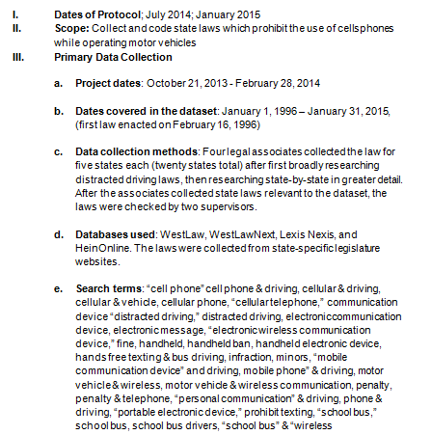
Research protocol
The research protocol outlines the entire methodology and process of the project, including:
The scope of the project, including dates of the project, team involved, jurisdictions, purpose of the project, and variable measured
Data collection methods, including search strategy and databases used
Coding methods, including coding scheme and definitions of terms of art
Description of quality control measures

Slide 12
Data file
The data file is a spreadsheet that contains the statistical data from a project
The data file is automatically generated by the MonQcle software
Data files facilitate further research
Overlay with outcome data
Academic research
Provides access to legal data
The data file is compatible with both CSV and Excel

Slide 13
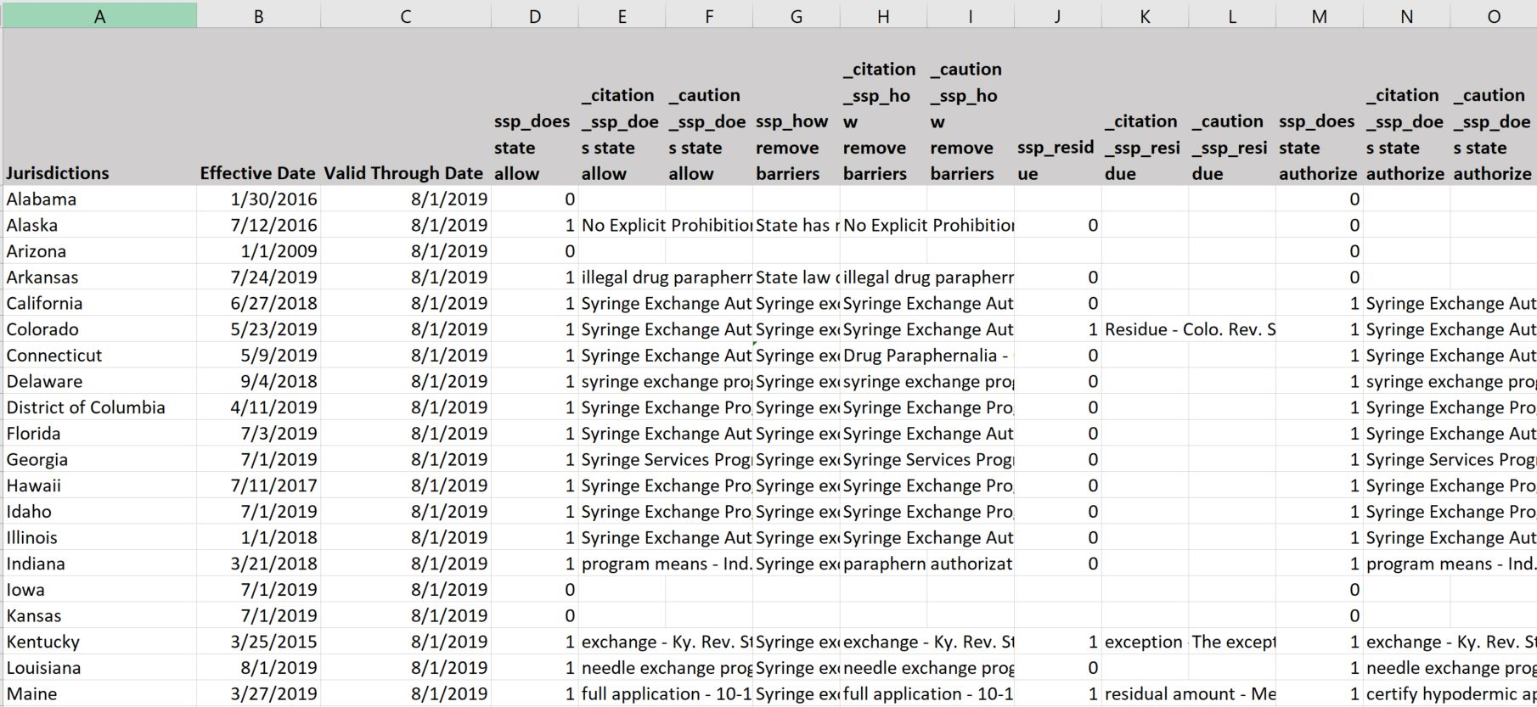
Data file example
Notes:
When using the MonQcle tool to conduct policy surveillance, the data page is automatically generated as seen above. The system will convert the responses to each question into statistical format, where it can be used for analysis.

Slide 14
Codebook
A codebook is a document that defines the variables and values included in the project – it is used in conjunction with the data page to perform analysis or to aid in understanding the research and coding
The codebook is automatically generated by the MonQcle software

Slide 15
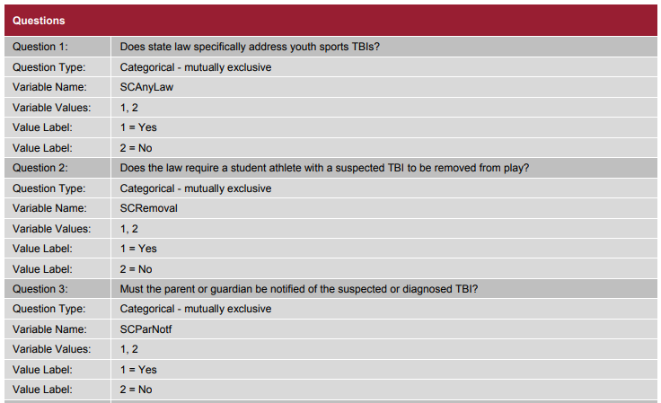
Codebook
A codebook is a document that defines the variables and values included in the project – it is used in conjunction with the data page to perform analysis or to aid in understanding the research and coding
The codebook is automatically generated by the MonQcle software
Notes:
If you are using the MonQcle to conduct your research, the MonQcle automatically generates data when it is used to code. If you are using an alternative tool for your coding, data must be manually inputted into an excel spreadsheet once coding has been completed.
The MonQcle also automatically generates a codebook which defines the variables in the data page. Otherwise, a codebook must be manually written.
Writing a codebook consists of listing each question in a project, and defining what responses the variable labels in the data page correspond to.
For example, for the question “Is there a state law on cellphone-use while driving?”, the codebook would list the responses “yes” and “no”, and indicate what numerical value in the data page corresponds to each response.
Further research includes allowing other researchers to layer project data with related outcome data.
For example, someone may want to layer data from a project on distracted driving laws with traffic accident data in the same jurisdictions.
An example and template of the data page and codebook can be found in Module 7, “Publication and Dissemination”, under related resources.

Slide 16
4. Publish and disseminate
There are several options for where to publish your data, including:
LawAtlas.org
When publishing on LawAtlas.org, heightened quality control measures are required
You (or your institution’s) website
Publish your data internally within your organization
Follow your dissemination plan to make your intended audience aware that the project has been published
Notes:
Deciding where to publish is based on the target audience, resources available, and the goals of the project.
We recommend an online outlet – like LawAtlas.org or your organization’s website so that data is readily accessible and may be updated regularly. If you plan to use your data to publish in a scholarly journal, you may want to wait to publish online or externally. So, you may choose only to share it internally with your fellow researchers.

Slide 17
4. Publish and disseminate
Once a project is completed, the data and maps that are produced can be used for additional research on the project’s topic. Publication could be accompanied by any of the following:
A one-page report that highlights interesting data points from the project
Comparative analysis of the jurisdictions evaluated
Law review articles
Comparative study of legal data and outcome data
For example, comparing distracted driving laws to crash statistics

Slide 18
Summary
“Publishing your project” consists of releasing your coded questions and responses (legal data) to your intended audience
“Disseminating your project” consists of making users and groups aware that your project has been published, and providing access to your published project
The steps involved in publishing and disseminating a project are as follows:
Plan the dissemination of the project
Questions to consider
Possible dissemination outlets
Final quality control checks
Finalize publication documents, when publishing to LawAtlas.org include:
Essential information
Research protocol
Data file
Codebook
Publish and disseminate

