Slide 1
Tracking and Updating the Law
LEARNING LIBRARY
FEBRUARY 2022

Slide 2
Learning objectives
Define “tracking and updating the law”
Learn the steps to track and update the law
  Search for updates
  Collect the law
  Create the legal text
  Code new iterations
  Quality control and updating
  Update publication documents

Slide 3
Defining “tracking and updating the law”
“Tracking and updating the law” consists of periodically checking for new laws and updates to existing laws that are included in a project

Slide 4
Steps in tracking and updating the law
1
Search for updates
2
Collect the law
3
Create the legal text
Republish project
4
Code new iterations
5
Quality control
6
Update publication documents
7
Notes:
**Research is conducted in batches of five jurisdictions at a time. Laws in those five jurisdictions are updated, new iterations are coded, and quality control is performed before moving onto the next five jurisdictions.
Search for the updates:
Researchers familiarize themselves with the project
Verify which jurisdictions have been in legislative session since the last update
Using citations listed on Master Sheets
Using search terms recorded on research protocol

Slide 5
1. Search for updates
Review the project’s coding questions
Read the research protocol, which includes information on:
  The scope of the dataset,
  Search terms that will be used to conduct research, and
  Definitions of terms of art
Researchers familiarize themselves
with the project
Notes:
Researchers should begin an update by familiarizing themselves with the project’s topic and methodology. Even in situations where the researcher worked on the dataset’s initial creation, it is a useful for them to refresh themselves on this information to avoid objective errors while researching and coding.
Researchers who are new to the project’s topic should begin by reading the background memorandums that were written for the dataset. All researchers working on an update should review the project’s research protocol.

Slide 6
1. Search for updates
Check for new laws or amendments in jurisdictions that had a legislative session since the last update
Verify which jurisdictions have been
in legislative session since the last
update
Notes:
When your project uses as a source of law, you will have to check all jurisdictions for updates, regardless of when they were in legislative session
Other jurisdictions have had no regulationsopportunity to enact new law
Executive orders and emergency amendments can result in unplanned changes to the law

Slide 7
Using citations listed on master sheets
Citations of relevant laws in a jurisdiction are collected in a Master Sheet document
There is one Master Sheet per jurisdiction
Master Sheet should include:
  The citation and title of each law
  The statutory history for each law
  And the effective dates
Alaska Master Sheet
Alaska Stat. § 12.55.035 Fines
3rd Sp. Sess. 2012, ch.1, § 19
        Effective July 1, 2012
SLA 2016, ch. 36 § 72
        Effective October 9, 2016
Notes:
Once the researcher is familiarized with the dataset, they are ready to begin checking the law for updates using the Master Sheets (created in Module 4).

Slide 8
Using citations listed on master sheets
Verify whether laws listed on the current Master Sheet for each jurisdiction have recent amendments, and update the Master Sheet accordingly
  Start by entering each citation on the Master Sheet into a legal search engine such as Westlaw or LexisNexis
  When a law has an amendment, add that amendment to the Master Sheet
Notes:
Once the researcher is familiarized with the dataset, they are ready to begin checking the law for updates
Master Sheets contain the statutory history for each law, so if a law has been updated, the credit history on Westlaw or Lexisnexis should include new amendments not listed on the Master Sheet.
Statutory history is the session law number for bills and agency notice for regulations

Slide 9
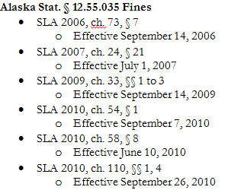
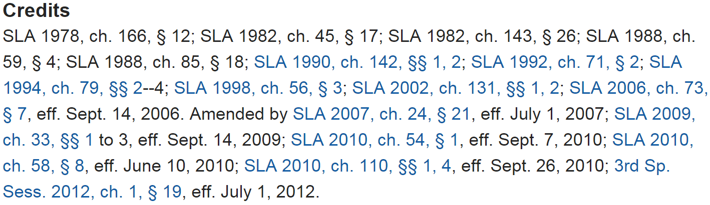
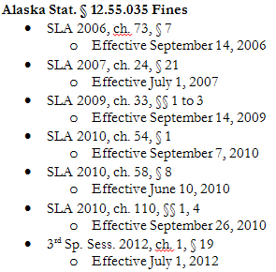
Search for updates: example
ALASKA MASTER SHEET
ALASKA STAT. § 12.55.035 CREDIT HISTORY
Update Master Sheet based on new amendment
Most recent amendment on Master Sheet
Notes:
The researcher will have to compare the amendments for each law in their Master Sheet to the amendments for those law on a legal search engine.
When there is an amendment for a law listed on the legal search engine which is not listed on the master sheet, the researcher should add the new amendment to their Master Sheet.
The credit history indicates where in a legislature’s session laws a specific amendment can be found, including the year, session number, and section.

Slide 10
Using search terms recorded on research protocol
The researcher should use the search terms listed on the research protocol document to find any relevant laws that have been enacted since the last update
  This search can be done on any legal search engine, such as Westlaw or LexisNexis
  New laws should be added to the master sheet along with their statutory histories and effective dates
Notes:
Using search terms will allow researchers to capture jurisdictions who are enacting a new law on a topic. For example, a jurisdiction could have no distracted driving laws when a project is first created, but in an update a researcher might notice that the same jurisdiction has just enacted a distracted driving law. So this check allows the researcher to identify jurisdicitons that went from no law on a topic to regulating a topic.
In addition, some jurisdictions may enact new laws to regulate a different area of a topic, which will also be captured by search terms.
Finally, search terms allow researchers to capture laws which were missed in the last round of research.

Slide 11
2. Collect the law
When a new law or amendment is enacted, it must be collected from an unencumbered source
Unencumbered sources can include state legislative websites
Using an unencumbered source to
collect new laws

Slide 12
3. Create the legal text
The “legal text” is the organized version of the relevant law for a jurisdiction:
Legal assessment (cross-sectional) – one legal text, for one jurisdiction, at one point in time
Policy surveillance (longitudinal) – multiple legal texts, for one jurisdiction, over a period of time
The legal text is used to code the law
Defining “legal text”
Notes:
For a full training on collecting the law, please refer to Module 4 in the learning library.

Slide 13
3. Create the legal text
Three types of documents are used to create the legal text:
The master sheet
The amendment tracker
Individual laws
In this step, you will learn how to use the amendment tracker and master sheet to create the legal text that will be used to code
Documents used

Slide 14
3. Create the legal text
The amendment tracker document:
List amendments to relevant laws in one jurisdiction, in chronological order
Created to serve as a guide when creating a policy surveillance project and updating a legal assessment project
Defining “amendment tracker”
Notes:
Amendment Tracker documents are important for building policy surveillance projects, because they show the progression of the law in a specific jurisdiction. Amendment Trackers list amendments to relevant laws in one jurisdiction in chronological order. You will have one Amendment Tracker for every jurisdiction included in the project.
They include the effective dates for each amendment, and descriptions of the changes made in each amendment.
Each entry in the Amendment Tracker reflects one version of the law that must be collected, built and coded in order to measure the law across the time period included in the project.
The next slide includes a sample of an Amendment Tracker used in a distracted driving laws project.

Slide 15
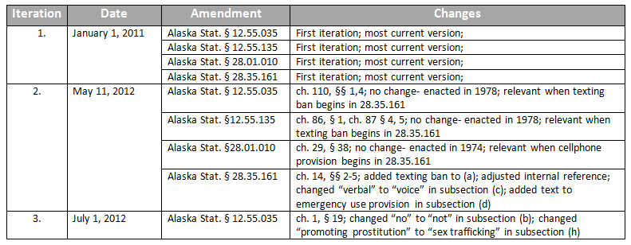
Creating an Amendment Tracker
Notes:
Amendment Trackers contain the following information:
Iteration number: This indicates the iteration of the law. An iteration is a set of specific provisions that constitute the relevant law for a given jurisdiction and time period. Every time any provision for a jurisdiction changes, a new iteration must be created. For example, if Alaska has four statutes for a topic, and one changes, a new iteration must be made. Likewise, if a relevant law in a jurisdiction is added or removed, a new iteration must be created.
The first iteration is always the start date of the project. In the example above, the project is tracking distracted driving laws beginning on January 1, 2011. Any subsequent iterations represent amendments to relevant laws that occurred after the start date. For example, the second iteration is on May 11, 2012, because a relevant law was amended with that effective date being May 11, 2012.
Date: This designates the effective date for the amendment you are describing. The effective date is the date the legislation becomes effective, not the passage date, or the signature date.
Amendment: This section includes the citation for the law that is being amended on that date.
Changes: This section indicates the nature of the change. Including detailed information about the nature of the change will make coding the law easier. This information can be obtained by reading the legal text and the statutory history notes.
For more information on creating an Amendment Tracker, see “How to Build an Amendment Tracker” under related resources.
Now that the law is organized hierarchically, and chronologically for policy surveillance projects, it is time to create the legal text which will be used to code.

Slide 16
Creating the legal text: for policy surveillance projects or for updating legal assessments
MASTER SHEET CITATIONS
FULL LEGAL TEXT FOR MAY 11, 2012
Alaska Stat. § 12.55.035 Fines
SLA 2010, ch. 110, §§ 1, 4
  Effective September 26, 2010
3rd Sp. Sess. 2012, ch. 1, § 19
  Effective July 1, 2012
Alaska Stat. § 28.01.010 Provisions uniform throughout state
SLA 2010, ch. 29, § 38
  Effective July 1, 2010
Alaska Stat. § 28.35.161 Use of electronic devices while driving; unlawful installation of television, monitor, or similar device
SLA 2009, ch. 42, § 1
  Effective September 18, 2009
SLA 2012, ch. 14, §§ 2-5
  Effective May 11, 2012
Alaska Stat. § 12.55.035 Fines (no changes)
Upon conviction of an offense, a defendant may be sentenced to pay a fine as authorized in this section or as otherwise authorized by law…..
Alaska Stat. § 28.01.010 Provisions uniform throughout state (no changes)
The provisions of this title and the regulations adopted under this title are applicable within all municipalities of the state.…..
Alaska Stat. § 28.35.161 Use of electronic devices while driving; unlawful installation of television, monitor, or similar device (2012 Amendment, ch. 14 §§ 2-5)
A person commits the crime of driving while texting, while communicating on a computer, or while a screen device is operating if the person is driving a motor vehicle, and……
AMENDMENT TRACKER
Iteration | Date | Amendment | Changes
2. | May 11, 2012 | Alaska Stat. § 28.35.161 | ch. 14, §§ 2-5; added texting ban to (a); adjusted internal reference; changed “verbal” to “voice” in subsection (c); added text to emergency use provision in subsection (d)
Notes:
This example is a demonstration of how we use the Master Sheet and Amendment Tracker together to create the legal text, to show the evolution of law over time in a Policy Surveillance project.

Slide 17
Creating the legal text
At this stage of the process, you have checked for updates, and have fully built the legal text that will be used to answer the coding questions.
FULL LEGAL TEXT FOR MAY 11, 2012
Alaska Stat. § 12.55.035 Fines Upon conviction of an offense, a defendant may be sentenced to pay a fine as authorized in this section or as otherwise authorized by law…..
Alaska Stat. § 28.01.010 Provisions uniform throughout state The provisions of this title and the regulations adopted under this title are applicable within all municipalities of the state.…..
Alaska Stat. § 28.35.161 Use of electronic devices while driving; unlawful installation of television, monitor, or similar device A person commits the crime of driving while texting, while communicating on a computer, or while a screen device is operating if the person is driving a motor vehicle, and……
Notes:
Now you are ready to code the law

Slide 18
4. Code new iterations
“Coding the law” consists of using the legal text collected to answer the questions developed
Module 3
Module 4
Module 5
Code answers to questions based on collected law
Develop questions
Collect laws
Notes:
Coding the law is where question development and collecting the law come together. Coding the law seeks to use laws that are collected for each jurisdiction in Module 4 to answer the questions that were developed in Module 3.
Coding the law can be performed using one of several legal mapping tools. It is possible to code the law using a software program such as Excel or Word, and some web-based tools exist that are designed specifically for coding legal questions, such as the MonQcle.

Slide 19
Coding example
QUESTION
LEGAL TEXT
RESPONSE
Alaska Stat. § 28.35.161 Use of electronic devices while driving; unlawful installation of television, monitor, or similar device
(a) A person commits the crime of driving while texting, while communicating on a computer, or while a screen device is operating if the person is driving a motor vehicle, and ……
(2) the person is reading or typing a text message or other nonvoice message or communication on a cellular telephone, personal data assistant, computer, or any other similar means capable of providing a visual display that is in view of the driver in a normal driving position while the vehicle is in motion and while the person is driving
What behaviors are restricted while driving?
Handheld electronic messaging
Handheld calling
Hands-free electronic messaging
Hands-free calling
A. Handheld electronic messaging

Slide 20
Code new iterations
Iteration 1:
December 1, 2001 - October 27, 2013
Iteration 2:
October 28, 2013 – January 1, 2016
NY VEH & TRAF § 1225-c Use of mobile telephones
[…]
4. A violation of subdivision two of this section shall be a traffic infraction
and shall be punishable by a fine of
not more than one hundred dollars.
NY VEH & TRAF § 1225-c Use of mobile telephones
[…]
4. A violation of subdivision two of this section shall be a traffic infraction and shall be punishable by a fine of not less than fifty dollars nor more than one hundred fifty dollars upon conviction of a first violation
Q: What is the maximum penalty for a violation?
Q: What is the maximum penalty for a violation?
A: One hundred dollars
A: One hundred fifty dollars
Notes:
For each time a law is amended, a new iteration must be coded on the MonQcle to reflect that amendment. Previous records should not be overwritten, new records should be added instead to show the evolution of the law over time.
Iteration – a version of the legal text for a jurisdiction, which represents the law at a specific point in time

Slide 21
Update the valid-through date
When updating a jurisdiction, the latest coding iteration should indicate when laws were researched so the team knows the dates these laws are guaranteed to be valid
This should be done even when a jurisdiction has no amendments or new laws that have been enacted. It indicates that the law has been checked for updates up to that point in time
Notes:
For example, if a project was last checked for updates on from January 1, 2016 to January 30, 2016, the valid through date should be updated to January 1, 2016 to indicate that the collected laws are valid up until that date.
The valid through date should be listed in the project’s research protocol.

Slide 22
5. Quality control
When performing updates, the same quality control measures that are used in the original creation of the policy surveillance process should be applied
The following measures should be implemented:
  Redundant research
  Redundant coding
  Final quality control check
When assigning redundant coding in an update, the first five iterations to receive an update are redundantly coded
  20% of any subsequent records are redundantly coded
The updated iteration is compared with the coding of the last iteration for each jurisdiction, to ensure that the coding in the update is consistent with the original coding
Notes:
See Module 6, Quality Control, for more information on how to perform QC.

Slide 23
6. Update publication documents
When re-publishing a project following an update, any ancillary publication documents, such as the data file for your project, should be updated.
Notes:
For more information on publication documents, please see module 7, Publication and Dissemination

Slide 24
7. Re-publish project
Upon the completion of an update, the project should be re-published on whatever dissemination outlet was initially used.
LawAtlas.org
Internally
Notes:
See Module 6, Quality Control, for more information on how to perform QC.

Slide 25
Summary
Updating the law includes the following steps:
  Search for updates
    Researchers familiarize themselves with the project
    Verify which jurisdictions have been in legislative session since the last update
    Using citations listed on master sheets
    Using search terms recorded on research protocol
  Collect the law
    Use an unencumbered source to collect new laws
  Create the legal text
  Code new iterations
  Quality control
  Update publication documents
  Re-publish project

